Slide 1
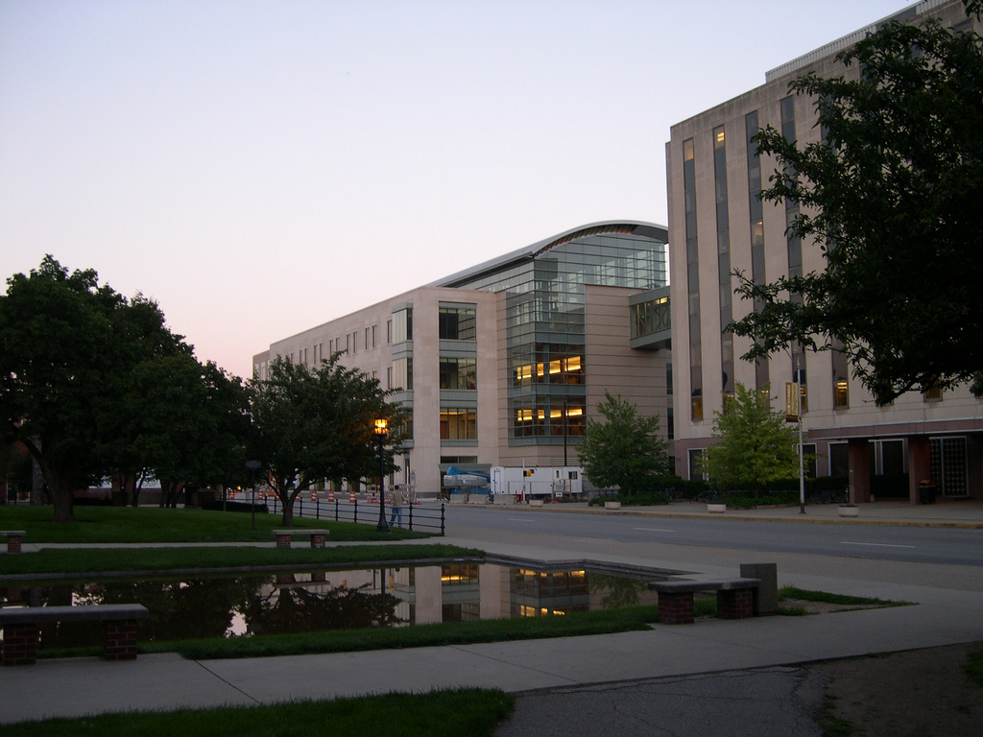

2018-19 Performance Evaluation Process
Success Factors
UPDATED
Good Morning and Welcome

Slide 2
University’s Expectation
Reports generated, exception reports
Firm deadlines, with a tie to the merit review process
Professional development and annual review
For all staff
Defined explicit goals for 2019
For Management and Professional staff
Doing your part

Slide 3
Development Plans
All staff must enter at least one developmental activity for 2018
Training that you attended or completed on-line
Skill that you learned on the job

Slide 4
Demo
Adding Development plans
https://www.purdue.edu/hr/lod/ProfDevPlan/index.html
Demo

Slide 5
Goals
All staff can enter goals for 2018, but are not required to do so. Any goals for 2018 will not effect your evaluation
Executive, Management, and Professional staff will be setting goals for 2019-20
Ability to update and log progress throughout the year
Supervisors and employees should be thinking about these goals and development plans now
Goals will represent 25% of your 2018 annual evaluation score, if you document any

Slide 6
Demo
Adding Goals https://www.purdue.edu/hr/lod/PerformanceGoals/index.html
Demo

Slide 7
Difference between Goals and Development Plan
“The development plan is for all staff and we are only asking that they upload one future professional development activity. The development plan is not tied to the annual evaluation process and it’s a long-term document that staff will continue to add to during their careers at PU.”

Slide 8
Krannert Weighting
Competencies will represent 75% of your annual evaluation score when coupled with goals representing 25%
Competencies will represent 100% of your annual evaluation score if you do not include goals for 2018

Slide 9
Competencies
Continuous Improvement/Change Management
Customer Service/Service Orientation
Job Performance
Teamwork
Supervision
Descriptors for each are located on Krannert’s Intranet site on the SuccessFactors – HR page
Competencies will represent 75% - 100% of your annual evaluation score

Slide 10
1-5 Rating system
1.0 Does Not Meet Expectations:
Significant aspects of the goal/competency were not accomplished, negatively impacting stakeholders and/or attainment of objective. Specific improvements are expected
2.0 Needs Improvement:
Significant (or some) aspects of the goal/competency were accomplished; however, improvements are needed to fully satisfy performance standards
3.0 Meets Expectations:
All aspects of the goal/competency were fully accomplished and the staff member’s contributions met all established criteria
4.0 Exceeds Expectations:
All aspects of the goal/competency were fully accomplished and the staff member’s contributions surpassed all established criteria
5.0 Outstanding:
All aspects of the goal/competency were fully accomplished and the staff member’s contributions surpassed all established criteria with distinction

Slide 11
Demo
Self Assessment
https://www.purdue.edu/hr/lod/Annual%20Evaluations/index.html
Krannert Competencies
Using the same ones we’ve used in the past
Changing them in the system
Demo

Slide 12
360 Feedback
2018 Evaluations
Select carefully
Condensed timeframe
2019 Forward
Timely – launch at any time
Employee or Supervisor can initiate but always do in consultation with each other

Slide 13
Demo
360 Feedback
https://www.purdue.edu/hr/lod/performanceManagement/Managers/supervisor_annual_successfactors.html
Demo

Slide 14
Timeline
3/20/19 - Employees complete the self-assessment portion of their evaluation
4/5/19 – Supervisors complete their staff’s assessment and schedule one-on-one meetings
4/30/19 – Completed, signed, and closed evaluations
On-going – Ability to access and update throughout the year

Slide 15
Additional Resources
Reference guide links
https://www.purdue.edu/hr/successfactors/training/goalsPerf/index.php
https://www.purdue.edu/hr/lod/Annual%20Evaluations/index.html

Slide 16
Workshops
Register for a General Performance Management Workshop Sessions:
Thursday, February 21, 2019 10:00-12:00 PM
Friday, March 1, 2019 2:00-4:00 PM
Thursday, March 14, 2019 2:00-4:00
Friday, March 22, 2019 2:00-4:00 PM
Monday, March 25, 2019 2:00-4:00 PM

Slide 17
Questions?

