Slide 1
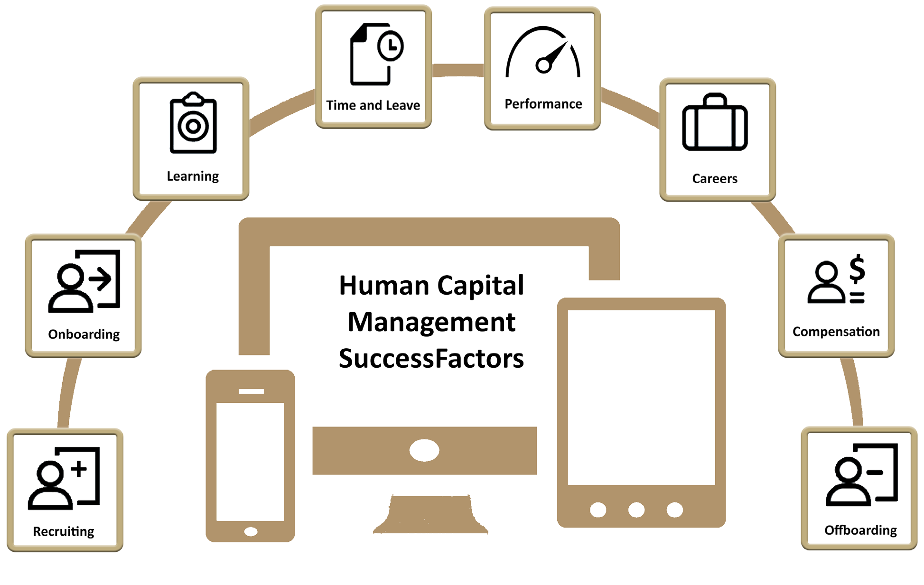
SuccessFactors Change Impacts
Deploys January 2019

Slide 2
Top Seven
Change Impacts
All recruiting activities processed through SuccessFactors
All timekeeping recorded through SuccessFactors
Supervisors review and approve timesheets (when applicable)
  Majority of benefit eligible staff on regular work schedules will have a negative time profile – requiring no supervisor approval (unless there is an exception, such as overtime)
All time-off (leaves) initiated and approved through SuccessFactors
New employees complete new hire paperwork through an online portal.
All performance appraisals completed and integrated with the merit process
Better position management –
  Can review your organizational chart with a click of the button
  Can have two people in one position in order to ‘hire and train’ new employee while current on is still in positions
  Department Support personnel can create positions for their director
  (with guidance from HR)
Notes:
Taleo, SEMS pause and 3rd party systems
KRONOS stops
No more time admin role fixing time before your approval – or approving for you – keep in mind the majority of people will be on a negative time profile requiring no approval
No more paper leave requests, leave requests tracked in Kronos or requested online through ESS – timesheets automatically push to payroll – so time and leaves will flow without approval . . .
We create enough new hire paperwork build our own bell tower out of paper!
Currently performance and merit don’t seem linked
We have to create another position – if want to hire and train the person while the other remains LTLs move to inactive positions and then back to active positions. . .and are required to complete an I-9 each time - ‘right to return’ functionality allows them to remain in the position and not have to complete I-9 each time they come back
Department support don’t normally create positions – however by allowing them to create the position – it will help since they are the ones who are initiating the posting of the position – it streamlines the process – so they can quickly both create the position (if it didn’t exist) and then post the position. They can easily copy and paste and HR –Comp will walk them through what they need to do

Slide 3
What Doesn’t Change?
Business Support staff will continue to initiate employee data changes (such as pay changes, position changes, time schedules, etc.)
  Can assist or complete student hiring process
  Will initiate direct hire processes (example – visiting scholar, fellowships, consultants)
  Create faculty e-offer letters
Business Management fiscally approve transactions
Human Resources – Compensation will review/approve position creation assist with organizational structure changes
Recruitment process incorporates current Provost and Dean approvals for faculty positions
Pay change approvals are similar to today
Notes:
The point is – your business office still supports you
Student hiring practices will be the same as today – if you go the business office to complete – they can do it or if you go to your department support – they can also complete student hiring. If you are a supervisor and am responsible for initiating or completing student hire – you can also do that.

Slide 4
Change Impacts
by Module

Slide 5
Creating New Positions
What’s changing?
From | To
Paper-driven process often kicked off with position description; HR - Compensation creates position in SAP; Payroll processes paperwork to put employee into position | Automated process allows position to be initiated by department and approved by HR – Compensation. Initiator can ‘copy’ information from like-job. Some information is pre-populated.
Key Benefits
Automated process and workflow Integrated information - can easily access like-position information Job family structure provides guidelines Less time from position creation to posting
Impacted Functions
HR – Compensation HR – Talent Acquisition Department can easily create position
Resources
Recruitment and Onboarding PowerPoint presentation (slide 5 and 6 ) Create Position Sneak Peek
Roles
Initiator - creates/edits position (Department Support personnel) HR Administrator – approves objects initiated outside HR

Slide 6
Faculty Recruitment
What’s changing?
From | To
Faculty recruitment processes are different across campus. Some utilize a SharePoint site or other departmental system to track candidates Others follow a paper process OIE manually gathers reporting Paper offer letters created through templates Request to post and offer letters routed for formal approvals All paper interview notes collected and sent to HR | One (automated) process allows: Department support to quickly initiate position and posting Initiator and recruiter can view candidate process OIE can initiate background check and gather needed data through SuccessFactors Electronic offer letters (utilize online templates) Online rating tool
Key Benefits
Automated process Integrated information – information gathered in recruitment flows to onboarding Reporting – one system; one process will standardize reports
Impacted Functions
Academic areas Provost (approval) Dean (approval) Business offices HR – Talent Acquisition
Resources
Recruitment and Onboarding PowerPoint presentation Review Sneak Peek

Slide 7
Staff Recruitment
What’s changing?
From | To
Today, Taleo is used to recruit staff position. Both position creation and request to post position are initiated through paper forms and then physically routed for signatures. Paper offer letters are created, based on templates, outside the system and physically routed for signatures Interview notes are gathered and sent to HR – Talent Acquisition. | SuccessFactors allows: Department support or supervisor can initiate in the system – position creation, posting Rate interviewed candidates within system – notes do not have to be forwarded to HR. Online offer letters completed through HR – Talent Acquisition and electronically routed for approvals New hire information collected in recruitment automatically pushed to onboarding module
Key Benefits
Automated process Transparency – candidate progress is easily viewable Integrated information – information gathered in recruitment flows to onboarding Reporting
Impacted Functions
HR – Talent Acquisition Business Office staff Department Support staff Hiring Supervisors
Resources
Recruitment and Onboarding PowerPoint presentation Review Sneak Peek

Slide 8
Student Recruitment
What’s changing?
From | To
Student hire process includes undergrads, grads and post docs
Student recruitment processes are different across campus. Some utilize Student Employee Management System (SEMS). Others follow a paper process Some only complete new hire paperwork. Sometimes offer letters were not utilized. | One (automated) process allows: Department support or supervisor to create position, create posting and quickly move student candidate to offer letter acceptance. Some areas will utilize the business office, similar to today, to complete student hire. Hiring process does not require formal approval. A simple offer letter is used to confirm candidate has accepted position.
Key Benefits
Automated process Integrated information – information gathered in recruitment flows to onboarding Reporting – one system; one process will standardize reports
Impacted Functions
Student Life Academic areas Grad School Business Office staff Department Support staff HR – Talent Acquisition
Resources
Recruitment and Onboarding PowerPoint presentation Review Sneak Peek

Slide 9
Onboarding New Employees
What’s changing?
From | To
Today, onboarding is decentralized. Each department determines the type of communication they extend to a new hire. New employee information is collected through paper forms. (Form 13, PA form, Tax, Direct Deposit, etc.) Request for Some new employees wait days/weeks to setup career account and gain access to systems. | SuccessFactors provides: Standardized processes for all new hires Department can custom welcome message, including linking important policies and other information for a successful first day A Portal is one-stop-shop to collect new employee information (online) needed for tax and payroll; I-9 and direct deposit included. (Notifications are sent if new hire is not completing information as required.) Once completed, new employee is automatically sent link to create career account and password.
Key Benefits
Automated process Information gathered in recruitment flows to onboarding New hire starts day one with access to system
Impacted Functions
Department Support Business Offices Payroll Hiring Supervisors
Resources
Recruitment and Onboarding PowerPoint presentation Review Sneak Peek

Slide 10
Crossboarding Employees (Transfers)
What’s changing?
From | To
Today, when an employee moves to another position/department: Paper process to update employee/department information Some departments utilize welcome messaging to ensure a productive first day | SuccessFactors provides: Standardized process – automatically updates information in employee record Department can custom welcome message, including linking information for a successful first day
Key Benefits
Automated process – no paper forms Integrated information – information gathered in recruitment flows to onboarding New employee (to department) could receive welcome message with important information
Impacted Functions
Department Support Business Offices Payroll Hiring Supervisors

Slide 11
Hiring Process (Personnel Actions)
What’s changing?
From | To
Today new hire information is collected manually and routed for approvals: Form 13 Personnel Action form Direct Deposit Tax forms I-9 completed through TALX by business office | Integrated information and automated process allows: New hire information collected in recruitment push to onboarding One-stop shop for new hire to log into portal and complete required information – limiting paper forms! I-9 is processed through SuccessFactors (process similar to today) but auto feeds information, so I-9 renewals are automated
Key Benefits
Automated process provides quick employee record turn around time, Integrated information from recruitment/onboarding to EC, decreases manual entry (and results in less errors) Automated I-9 renewal process
Impacted Functions
Payroll and Tax Business Office staff Hiring Supervisors
Resources
Onboarding and Manage Pending Hire Deep Dive

Slide 12
Employee Data Changes (Personnel Actions)
What’s changing?
From | To
Today employee data changes: Documented on a personnel action (PA) form Sometimes difficult to select the right ‘event’ reason Physically routed for approval Sent to payroll to key in system | Automated process allows: An initiator (business office) to request data change in SuccessFactors Workflow routes to proper approvers (dependent on change) Minimal data entry Event and event reason are derived
Key Benefits
Automated process provides quick employee record turn around time Integrated information from recruitment/onboarding to Employee Central, decreases manual entry (and results in less errors) Automated I-9 renewal process
Impacted Functions
HR - Compensation Payroll and Tax Business Office staff Hiring Supervisors Workflow approvers – such as Department Heads
Resources
Employee Data Change Sneak Peek

Slide 13
Terminations (Personnel Actions)
What’s changing?
From | To
Today terminations are: Documented on a Personnel Action (PA) form and sometimes processed with Quota Payout form Physically routed for approval Sent to payroll to key in system | Automated process allows: An initiator (business office) request termination in SuccessFactors Workflow routes to proper approvers Quota payout processed by Payroll Event and event reason are derived
Key Benefits
Automated process removes forms Automated calculations reduce manual entry and error Integrated information updates other areas (vacancy will show in org chart)
Impacted Functions
Payroll and Tax Business Office staff Workflow approvers
Resources
Deep Dive – Data Changes, Terminations, Quota Payouts

Slide 14
Time, Leaves (Time-off) and Quotas
What’s changing?
From | To
Today time and leaves: Are manually entered through a paper timecard or Form 33 – physically routed for approval Some use Kronos and Working Time (SAP) to request time off –but is inconsistent Most utilize a time admin role to key time and leaves Some fix time, audit or perform calculations for things like call back pay Little visibility to accurate leave balances, specifically for exempt sick leave | In SuccessFactors, Work schedule and time profile are used to correctly calculate OT, Call Back Pay and other pay premiums (no more manual calculations.) They also accurately reflect holiday pay Employees can view accurate sick and vacation balances, including employed grad students Accurate sick leave balance available for exempt staff Negative time profiles decrease number of timesheets requiring approval Only supervisor/employee can view and edit time sheets Automated calculations eliminate the need for a time admin to view/edit time
Key Benefits
Automated process decreases manual entry Programed calculations within system decrease manual calculations Negative time profile decreases number of supervisors approving timesheets Accurate leave balances eliminates tracking sick leave via excel and having to double and triple check with other departments
Impacted Functions
Payroll and Tax Business Office staff Employee/Supervisor
Resources
Time and Leaves Sneak Peek

Slide 15
Timekeeping
What’s changing?
From | To
Today timekeeping: Is manually entered through a paper timecard or electronically through Kronos Some areas utilize a time admin role to fix time, audit or review calculations (such as call back pay) Paper timecards provide little visibility to accurate leave balances, specifically for exempt sick leave | With Mobile App and SuccessFactors A mobile app will be used for those required to clock in/out (Kiosks will also be available utilizing iPad) Mobile app will use location service Only supervisor/employee can view and edit time sheets Automated calculations eliminate the need for a time admin to view/edit time
Impacted Functions
Employee/Supervisor Business Office Payroll IT
Key Benefits
User friendly mobile app Timesheet is automatically updated Employee can easily fix time (if missed punch) Notifications are provided to employee when there is a missed punch
Resources
Time and Leaves Sneak Peek

Slide 16
Performance Appraisals and Goals
What’s Changing?
From | To
Today, staff goals and performance are: A combination of automated and manual processes Inconsistent with respect to staff performance periods Decentralized and inconsistent in our methods for setting and tracking goal accomplishment, development plans, and annual staff 360 feedback processes | SuccessFactors provides: A single automated system with standard processes across all campuses A single performance period for all staff A single automated and streamlined goals management, development planning, and annual staff evaluation 360 feedback process
Key Benefits
Goals management and development planning dashboards help supervisors and staff define, cascade, and track operational and strategic objectives The writing assistant and other performance management tools help supervisors and employees document performance accomplishments at the end of the year Value added standardized reports are available to management and supervisors on the SuccessFactors home page
Impacted Functions
HR – LOD HR – Compensation Business Offices Department/College Leadership Supervisors and employees completing appraisals
Resources
Review the information available on LOD – Performance Management webpage

Slide 17
Merit Process
What’s changing?
From | To
Today: Merit process is outside the SAP system Time-consuming, manual process, excel-driven There are different processes for merit, extra merit, equity and administrative adjustments Performance appraisal ratings are not integrated with merit process | Automated process allows: Merit planning form in SuccessFactors Form includes merit, extra merit, equity and administrative adjustments - providing leadership a broader compensation view Workflow automatically moves form to correct approver(s)
Key Benefits
Automated process decreases significant process time and manual calculations Integrated information from EC prepopulates employee information; performance ratings integrated Standard process for merit, extra merit, equity and administrative adjustments
Impacted Functions
HR - Compensation Payroll and Tax Business Office staff Financial Planning and Analysis Unit heads serving as Compensation Manager

Slide 18

Prepare
Talk to your employees or managers. Share information, point people to helpful resources, send questions to bpr@purdue.edu
Consider how your supervisory structure will support the new automated workflows in time and reporting.
Visit https://purdue.edu/successfactors site often to see updates to the changes impacting you.
View the sneak peeks to learn more about SuccessFactors navigation.

