Slide 1

Business Office
Topics
General Ledger (GL) List
Credit Cards
Hospitality

Slide 2

Business Office
General Ledger (GL) List
GL is the code describing the type of expense or revenue
GL is the same as Commitment Item (depending on the report being reviewed)
Need to use the common GL list provided by the business office Intranet page
If unsure of what GL code to use, please contact the business office

Slide 3
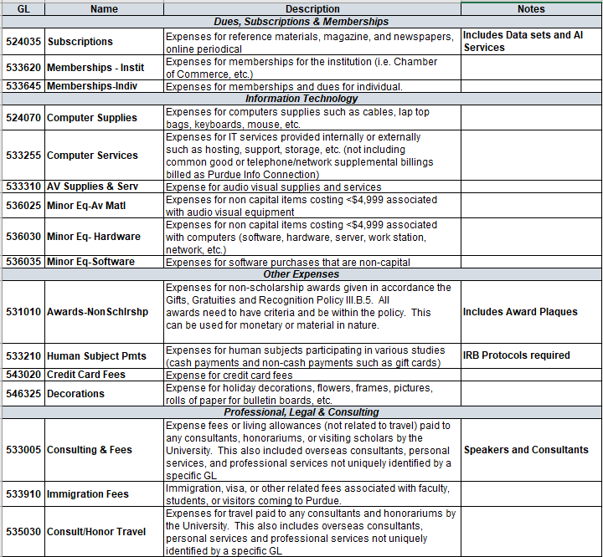
Business Office
Common GL List

Slide 4
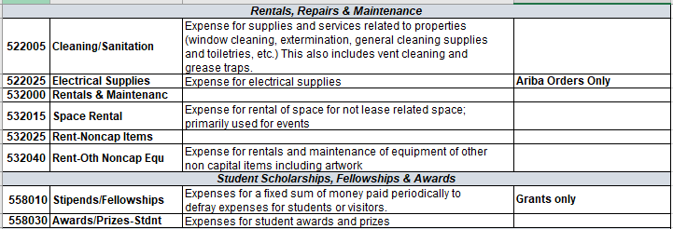
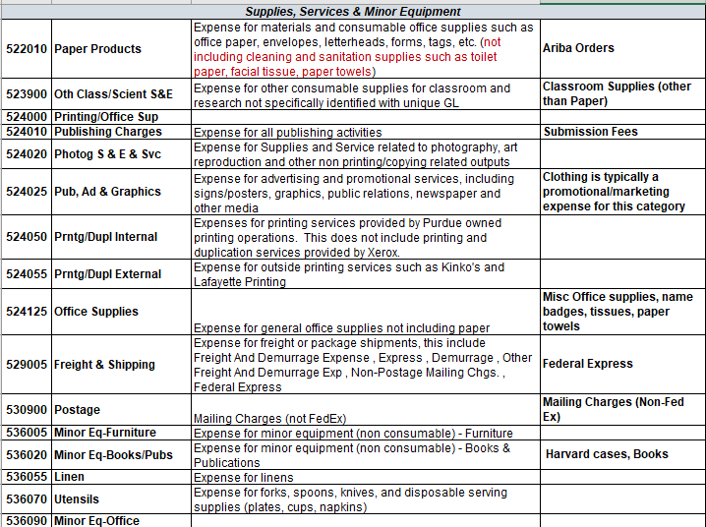
Business Office
Common GL List continued

Slide 5
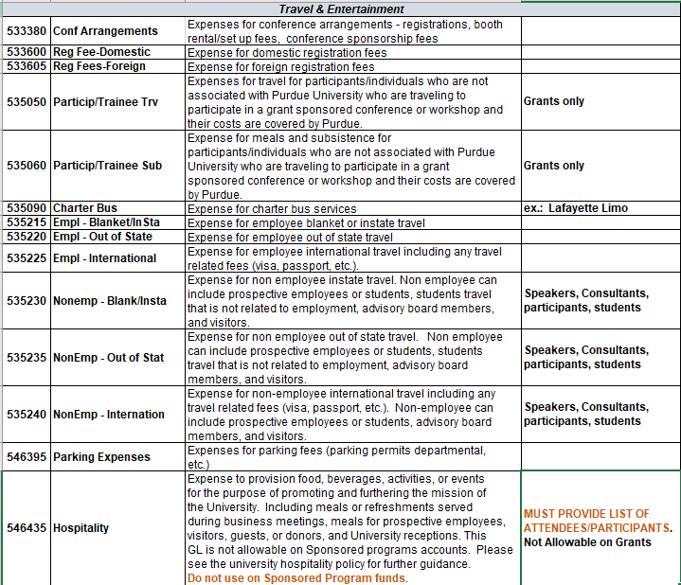
Business Office
Common GL List continued

Slide 6
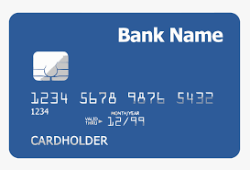
Business Office
University Credit Cards
Purchasing Cards (pcards)
  Department Card
  Named Card (must not be used by anyone other than named person on card)
Travel Cards (tcards)
  Named Card (follows the employee no matter what area they work in)
PRF (Purdue Research Foundation) Cards
  PRF purchases need to be approved by the business office
  ALL PRF expenditures are subject to Indiana Sales Tax

Slide 7
Business Office
University Credit Cards
Limit Increase Requests
  Contact the business office for increase requests
    busproc@purdue.edu
Pcard & Tcard Reconciliations are processed in Concur
  Maintain all receipts for reconciliation
    Itemized receipts needed versus “balance paid” as details are needed
  PRF cards are reconciled via a separate process
Fraudulent charges should be reported by calling the bank and then notifying the business office
If card is declined, contact the bank first to make sure what caused the decline (i.e. over single/cycle limit)
https://www.purdue.edu/procurement/card-services/common-decline-codes.php

Slide 8
Business Office
University Credit Cards
Purchasing Cards (pcards)
  Allowable Uses
    Is the item available through the University’s e-procurement tool?
      https://www.purdue.edu/procurement/purchasing/index.php
    If the purchase can be made through the University’s e-procurement tool, do not use the pcard
    If the item cannot be made though the University’s e-procurement tool, first make sure it is not a prohibited item. If not, the pcard can be used
    Is it a repetitive purchase?
      If so, Procurement Services should be contacted for other procurement methods to acquire the item.
      If not, a pcard can be used
    The University is tax exempt
      But food and beverage provided by a caterer or restaurant are NOT exempt

Slide 9

Business Office
University Credit Cards
Purchasing Cards (pcards)
  Prohibited Uses
    Personal Transactions
    Cash Advances
    Travel & Entertainment
    Alcoholic Beverages (unless being charged to a MS Program account)
    Escort Services
    Capital Assets (any tangible items >=$5,000)
    Personal Service Payments
    Cylinder Gases
    Fuel

Slide 10
Business Office
University Credit Cards
Purchasing Cards (pcards)
  Prohibited Uses (cont)
    Commodities or services required to be purchased through current contracts or that are available through the university e-procurement tool
    Used at auctions or for used equipment on Ebay
      Contact Procurement for assistance with these types of purchases
    Printing Services
    Any goods or services not directly benefiting Purdue University
    Splitting large transaction into smaller transactions to circumvent the approved transaction limit policy

Slide 11

Business Office
University Credit Cards
Travel Cards (tcards)
  Allowable Uses
    Airfare
    Baggage Fees
    Lodging
    Car Rental (including gasoline)
    Registration Fees
    Parking
    Ground Transportation
    Meals -- Meals are an allowable business expense and may be charged to the Visa Travel Card while in travel status. These charges are non-reimbursable and should be identified as “Meal Expense” and marked “personal” on an Expense Report. Meals are included in the per diem reimbursement provided to travelers.
    Meals that are Hospitality related ONLY when in travel status
    Cash Advances (while in travel status)
      Limited to $500 per cycle

Slide 12
Business Office
University Credit Cards
Travel Cards (tcards)
  Prohibited Uses
    Personal transactions
    Alcoholic Beverages (unless being charged to a MS Program account)
    Escort Services
    Making charges while not in travel status and not related to university business
    Allowing someone else (co-worker, family, friend) to make purchases
    Payment for insurance, including car rental, lost baggage and travel related

Slide 13
Business Office
University Credit Cards
Travel Cards (tcards) Violations
1st Violation – email to cardholder, supervisor, with copy to the Business Office manager.
2nd Violation – email to cardholder, supervisor, with copy to the Business Office manager and card is suspended for three months.
3rd Violation – email to cardholder, supervisor, with copy to the Business Office manager and card is suspended for one year.
Please Note: The University follows the IRS “accountable plan” rule on submitting and reimbursement of expenses found in IRS publication 463. Expense reports not cleared within 120 days after the last day of travel on official university business are reported as additional wages to the employee.

Slide 14
Business Office
University Credit Cards
PRF Cards
  Allowable Uses
    Meals/Refreshments (including alcoholic beverages for University guests and staff who host them)
    Bereavement: Funeral flowers costing <$100 and sympathy cards for students, staff and donors
      Flower purchase for birthdays/births is not allowed
    Flowers/Cards:
      Seasonal flowers to decorate common areas
      Birthday, congratulatory, thank you, or holiday cards for donors
    Placards and Mementos:
      Appreciation to donors in compliance with IRS regulations
    Miscellaneous:
      Coffeepots/small appliances
        Does not include purchase of coffee or creamer
      Sponsorships when used for public relations purposes or advertisement

Slide 15
Business Office
University Credit Cards
PRF Cards
  Prohibited Uses
    Gifts or benefits to employees, unless part of a University or departmentally sponsored recognition program
    Travel expenses for spouses of University officials not acting as official volunteers or representatives of the University
    Reimbursement of local travel expenses
    Payment of fines or penalties
    Purposely avoiding University travel regulations or procurement policies
    Memberships for various organizations
    Donations to charities and/or civic fund-raising campaigns
    Office parties, holiday parties, or decorations
    Refreshments at routine staff meetings
    Payment in cash/equivalent (e.g. gift certificates) may only be made through the University , when allowable

Slide 16
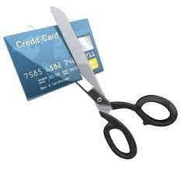
Business Office
University Credit Cards
PRF Cards Violations
First violation may result in immediate cancellation of PRF card.
Business expenditures that are unallowable on PRF funds will result in reimbursement by the employee with possible cancellation of the PRF card.
Personal expenditures will result in reimbursement by the employee and/or disciplinary actions including suspension, termination and prosecution under state and federal laws.

Slide 17

Business Office
Hospitality
Hospitality Expenses are considered provision of food, beverages, activities or events for the purpose of promoting and furthering the University’s mission
Allowable Hospitality Expenses (3 Categories):
  Meals/Refreshments served during business meetings
  This is an exception and shouldn’t be commonplace for meetings
    Served at University sponsored seminars, retreats, workshops or other University functions
    Served during University sponsored meetings of advisory groups, outside reviewers, or other committees when the group is composed of both University employees & non-employees
    Served at a working breakfast, lunch or dinner meetings, when groups of employees are giving up personal time to conduct University business. A formal business discussion must be the purpose of the gathering.
    https://www.purdue.edu/policies/business-finance/iia1.html

Slide 18
Business Office
Hospitality
Allowable Hospitality Expenses (3 Categories) cont:
  Meals for prospective employees, visitors, guests, or donors
    Related to individual recruitment of faculty or staff
    Related for individuals invited as academic visitors to contribute to the intellectual life of the University community (i.e. delivering a seminar, colloquium talk or other lecture or performance that benefits the University faculty and/or students)
    Related to marketing University facilities and services to secure potential conference business
    Related to cultivation of donor prospects, whether prospective or previous donors

Slide 19
Business Office
Hospitality
Allowable Hospitality Expenses (3 Categories) cont:
  University Receptions
    For any employee who retires or terminates from the University, providing that the employee has 15 or more years of service or is an official University retiree
      Contact the business office to confirm years of service and retiree status
    For faculty, staff, and students/families when the predominant number of those in attendance are students
    In order to present/acknowledge awards to faculty, staff, students, and alumni for outstanding accomplishments
    In order to honor visitors, guests or dignitaries

Slide 20

Business Office
Hospitality
Unallowable Hospitality Expenses (this list is not to be considered exhaustive):
  Alcoholic beverages (unless being charged to a MS Program account)
  Holiday or other social functions
  Flowers (exception- serve as a decoration for an allowable event)
  Musicians
  Meals for employees
  Items of a personal nature (examples- golf clubs, memberships in social organizations, etc)
  Gifts and charitable contributions

Slide 21
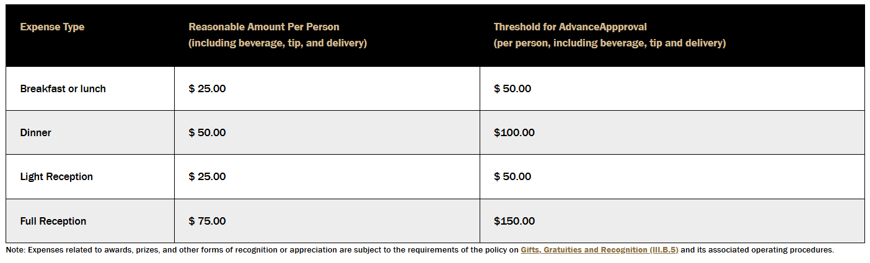
Business Office
Hospitality
Must provide itemized receipt and list of attendees for a hospitality expense
Reasonable amounts for common Hospitality Expenses. Any Hospitality Expense expected to be above the threshold must be approved in advance.
https://www.purdue.edu/treasurer/finance/controller/polices-procedures-resources/#:~:text=The%20matrix%20below%20lists%20reasonable,%2C%20tip%20and%20delivery):%20$150.00

Slide 22

Business Office Contacts
Adam Wilson, DFA
Heather Underwood, Business Manager
~Supports MS/MBA Programs
Reece Dewell, Business Manager
Michelle Gentry, Lead Business Asst.
~Payroll
Sandy Johnson, Business Asst.
~Reimbursements, Credit Cards
Jonathan Maj, Research Acct Specialist
~Grants
Patty Whaley, Financial Analyst

Slide 23

Business Office

Slide 24

Business Office

