Slide 1

Business Office
Refresher Training

Slide 2

Business Office
New Decision Guide
Reimbursement Overview
Student Expense Clarification
Invoice Submission
NonEmployee/Student Travel Arrangement
Contracts/Agreements
Credit Cards
General Ledger (GL) Overview
Hospitality

Slide 3
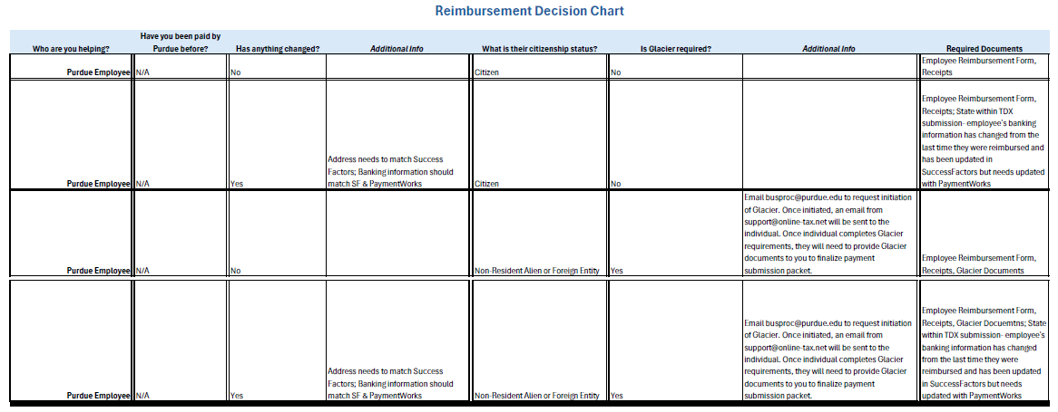
Business Office
Purdue Employee Decision Guide
https://apps.it.purdue.edu/sites/BusinessOffice/Faq/Item/955

Slide 4
Business Office
Reimbursements
Required documents will be submitted via Team Dynamics (TDX)
  TDX Entry Instructions
Confirm if any information has changed from their most recent reimbursement
    Address and Banking Information should be current in Success Factors for Employees
    Banking Information Change should be updated in Success Factors and with Payment Works for Employees
    Any changes for nonemployees will be routed via PaymentWorks
Provide Proof of Payment (ie. receipts)
  Receipts MUST be legible/readable
  Last 4 digits of card # should be on receipt
Personal purchases that are 180 days or older from the date of the transaction noted on the proof of payment are no longer eligible for reimbursement
If mileage is requested, Google Maps should be used to show the most direct route and calculated mileage.

Slide 5
Business Office
Reimbursements
Payee Certificate (PC)
  Reason for payment is clear & detailed so if audited understandable by someone who does not have first-hand knowledge about the transaction
  Digital signature is allowed via DocuSign
        DocuSign link
  Account Information section
        The account # will either be an Order (ie. 3200002472) or WBS Element (ie. F.10075970.03.001) (not both)
        GL code is required
Missing Receipt Form
    Must be completed if any expense does not have a receipt or it has been lost

Slide 6
Business Office
Reimbursements
  Form 17C
    This One-Time Vendor process eliminates the need to set up new vendors with Payment Works.
      Should ONLY be used for reimbursement of travel expenses (CANNOT be used to pay a speaker fee/honorarium)
    All submissions must include supporting documentation
    Payee Certificate Form is ONLY required when a prospective candidate attends with a dependent
    Provide detail description for purpose (ie. Speaker/Dept/Reason)
    The account # will either be an Order or WBS Element (not both)
    GL code is required
    Approval: Once form is completed, send via DocuSign to Adam Wilson to approve and sign on the For The President section.
Form 17C Instructions
ACH Form
  Should not be submitted via DocuSign as the form contains restricted/sensitive data
  If a candidate wants paid via ACH, then a Sub W9 or ACH form is needed for processing.
  If a candidate is fine with being paid via check, then the address on the Form 17C is appropriate w/o Sub W9 or ACH.
Notes:
Program Manager/ person compiling forms should review before sending to the business ofifce

Slide 7

Business Office
Reimbursements
Glacier (Required for International Employees & NonEmployees)
  For International Employees: This is a good point for them to use department pcards so they do not have the extra step of Glacier
  Notify the individual that they will receive an email from support@online-tax.net that needs to be completed before payment processing (Important to note: these emails can end up in the individual’s junk/spam folder)
  Notify the business office (busproc@purdue.edu) that you have a reimbursement for a Non-Resident Alien or Foreign Entity and request Glacier be initiated.
      Provide individual’s full legal name
      Provide the individual’s email
      If Purdue student, provide their PUID
      Individual will need to provide I94, I20, Passport/Visa Stamp, and Tax Summary from Glacier (I20 and Tax Summary must be signed with a handwritten signature)
Glacier Process Guide

Slide 8
Business Office
Clarification Purdue Student Expenses
If the expense primarily benefited Purdue, it should be reimbursed as a business expense; if it primarily benefited the student, it should be classified as a scholarship or award and reported to DFA.
It is a Class Expense being paid for multiple students and covered by course fees: No need to report to DFA
Is it an Academic Program Requirement? Yes: Report to DFA with details
  Academic Program Definition – A combination of major and degree type which the student is pursuing.” Requirements of an academic program would be requirements for the major or minor to receive a degree. Example: Students majoring in X are required to travel to Y and provide a research paper on their observations to fulfill the requirements of one of their core major classes.
Not related to the requirements of a student’s academic program:
With Receipts: Does NOT need reported to DFA; not considered OFA.
Receipts MUST be kept for auditing purposes in the DSB Business Office.
Without Receipts: Report to DFA as is considered OFA.
Student Reimbursement Guidelines
Student Reimbursement Method Decision Tool - Once the form is completed and submitted, a summary of your answers will be sent to your email address with instructions on next steps. Please use this as backup for the identified payment actions.
Student Reimbursement Method Flow

Slide 9
Business Office
Invoice Submissions
When paying a vendor:
  If they are a new vendor for Purdue and you have the invoice, submit via the Invoice Payment (ZV60) tile and note vendor is new.
    EOBOC will take care of initiating the creation of their vendor account with PaymentWorks
    Once PaymentWorks confirmed their account is set up, EOBOC will proceed with payment of the submitted invoice (as long as account # & GL# provided)
  If you have a vendor that you know will be paid in the future and you want to go ahead and get them established as a vendor with Purdue, submit via the Vendor Request/Change tile

Slide 10
Business Office
NonEmployee or Employee w/no tcard
How can a student, nonemployee or employee with no tcard arrange travel?
  Arrange in Concur or with AAA Corporate Travel
  Concur is the preferred method to book travel
  AAA handles comprehensive travel services (air/ground transportation, lodging, travel for 10 or more individuals, 24/7 assistance)
    If assistance is needed with planning a trip the University corporate travel contact is AAA (purduetravel@aca.aaa.com ) #877-379-0299.
    For AAA Domestic reservations, contact AAA via #800-381-0971.
Other self-booking tools
  Does not allow the traveler to use established partner discounts
  Does not provide Purdue with a record of travel to locate the traveler in the event of an emergency
  Does not allow the travel agency to provide rebooking or travel issue support
Purdue Travel is available for questions at purduetravel@purdue.edu

Slide 11

Business Office
Contracts/Agreements
All contracts/agreements must be submitted to the business office for review
  Only individuals with Fiscal Signature authorization are allowed to sign contracts (i.e., Business Office staff, Procurement Contracts staff, etc.).
  Please do not sign any agreements without first checking with the Business Office.
Links for additional information:
    https://www.purdue.edu/procurement/contracts/index.php
    https://www.purdue.edu/procurement/contracts/contract-types.php

Slide 12
Businesss Office
University Credit Cards
Purchasing Cards (pcards)
  Department Card
  Named Card (must not be used by anyone other than named person on card)
  Allowable/Prohibited expenses found on pages 11-12 of manual
  The University is tax exempt (Prepared food and beverage provided by a caterer or restaurant are NOT exempt)
Travel Cards (tcards)
  Named Card (follows the employee no matter what area they work in)
  Allowable/Prohibited expenses found on pages 4-5 of manual
  Meals that are Hospitality related ONLY when in travel status
PRF (Purdue Research Foundation) Cards
  PRF purchases need to be approved by the business office
  Allowable/Prohibited expenses found on page 6 of manual
  ALL PRF expenditures are subject to Indiana Sales Tax

Slide 13
Business Office
University Credit Cards
Credit Card Applications
  Must contact the business office for increase requests
    busproc@purdue.edu
Limit Increase Requests
  Contact the business office for increase requests
    busproc@purdue.edu
Pcard & Tcard Reconciliations are processed in Concur
  Maintain all receipts for reconciliation
    Itemized receipts needed versus “balance paid” as details are needed
  PRF cards are reconciled via a separate process
All cards should have a maintained sign-out log
  This log is helpful when an unexpected expense appears in Concur during your reconciliation process
Fraudulent charges should be reported by calling the bank and then notifying the business office
If card is declined, contact the bank first to make sure what caused the decline (i.e. over single/cycle limit)
https://www.purdue.edu/procurement/card-services/common-decline-codes.php

Slide 14
Business Office
University Credit Cards
Procurement Card (pcard) Violations
Central will issue a formal audit finding and issue non-compliance/violation notifications as required.
The type of response to a violation or if a pattern of violations will depend on the type, frequency and severity of the violation and may include:
    Written non-compliance notification
    Suspension of the card
    Personnel actions, up to and including termination
    Travel Card (tcard) Violations
    1st Violation- email to cardholder, supervisor, with copy to Business Office Manager
    2nd Violation- email to cardholder, supervisor, with copy to Business Office and card is suspended for 3 months
    3rd Violation- email to cardholder, supervisor, with copy to Business Office and card is suspended for 1 year
    PRF Card Violations
    First Violation could result in immediate cancellation of PRF card.
    Unallowable expenses will result in reimbursement of charges by the employee w/possible cancellation of card.

Slide 15
Business Office
University Credit Cards
PRF Card
Maintain Sign-Out Sheet
  This form is required before each use of the PRF card
    Provide detailed activity description
    List of attendees (if applicable)
    Amount requested
  Original, Itemized receipts must be returned with the card after each use within 24 hours of use
How to Reconcile
  Provide Reconcile documents noted below by the 20th of each month
    PRF cycle period is 16th – 15th each month
  Access JPMorgan site via your assigned login information
    Compare the JPMorgan’s transaction report against collected receipt(s)/packing slips
  Save Statement Detail as a PDF
  Submit via FileLocker to Carrie Clark (clar1365@purdue.edu) sign-out log, itemized receipts, statement, expense justification explanation for each transaction

Slide 16
Business Office
General Ledger (GL) Codes
Need to use the common GL list provided by the business office
  Found on Business Office Intranet page
If unsure of what GL code to use, please contact the business office
Do NOT use dropdown options for GL codes
  Incorrect GL codes are being chosen and the business office must correct on the backend

Slide 17
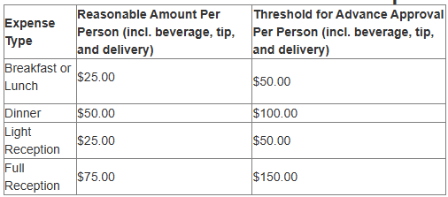
Business Office
Hospitality Expenses
When submitting Hospitality expenses, please place in the Comments section of TDX the Business Purpose
A list of attendees is required for all charged Hospitality expenses
  Add to all submissions (TDX, Pcard/Tcard/PRF reconciliations)
Hospitality Guidance
Reasonable amounts for common Hospitality Expenses:
https://www.purdue.edu/treasurer/finance/controller/polices-procedures-resources/

Slide 18

Contact Information
EOBOC Procurement:
  procureeo@purdue.edu
General Business Office:
  busproc@purdue.edu
    Use our general email for general business office requests (ie. credit cards, reimbursements, invoices)
Business Office Single Point of Contact

Slide 19

Business Office
Any Questions?

Slide 20

Business Office

