Slide 1

Business Office
Reimbursement Process

Slide 2

Business Office
Decision Charts
Reimbursements
  Employee
  Non-Employee
  Candidate
  Purdue Students
Team Dynamix Information
Payment Works
Forms Rejected, WHY??
FileLocker
DocuSign
GL List
Tips & Tricks
Contacts
Meeting Video
Recap: Reimbursement Training/Refresher Wednesday, October 15 | Meeting | Microsoft Teams

Slide 3
Business Office
Reimbursement Decision Chart
Reimbursement Decision Chart
Purdue Employee Decision Chart (page 1)
Non-Purdue Employee Decision Chart (page 2)
Vendor Decision Chart (page 3)
Non-Purdue Employee Travel Decision Chart (page 3)
Prospective Employee Decision Chart (page 3)
Purdue Undergrad/MS/Doctoral Student Decision Chart (page 4)
  Clarification Student Reimbursement
  Paid UG Student Reimbursement Guidance
  Student Look up in SuccessFactors

Slide 4
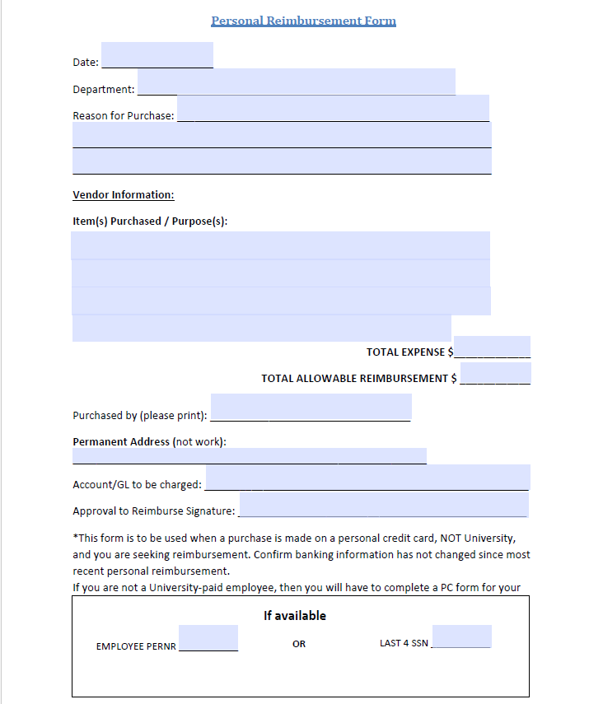
Business Office
Employee Reimbursements
Required documents will be submitted via Team Dynamics (TDX)
Complete Employee Reimbursement Form
  Employee requesting the reimbursement should complete
  Account number and signature required by the person approving the reimbursement
  Requesting area will complete the form’s bottom portion
  Confirm if any information has changed from their most recent reimbursement
    Address Change needs to be updated in Success Factors
    Banking Information Change should be updated in Success Factors and with Payment Works
  Note: Active Employees cannot be paid for worked performed via an invoice. Employees would be processed via Payroll for work performed.
Banking information follows what is in PaymentWorks not Success Factors

Slide 5

Business Office
Employee Reimbursements
  Provide Receipts (proof of payment)
    All receipts must be submitted
    Receipts must show last four digits of the card used to make the purchase
    If receipt does not show the last four digits, a bank statement can be submitted (screenshot acceptable) showing the purchase.
      The statement needs to show the last four digits of the account
      All personal information should be blacked out
    Personal purchases that are 180 days or older from the date of the transaction noted on the proof of payment are no longer eligible for reimbursement.
      Any exceptions will be determined by DSB’s DFA.
  Provide statement of Purdue business purpose (detail)
  If business travel, process through Concur
    If mileage is requested, Google Maps should be used to show the most direct route and calculated mileage.
      Double the mileage to show the roundtrip total and use that for the total reimbursement
        Mileage is currently reimbursed at the rate of 0.70

Slide 6
Business Office
Non-Employee Reimbursements
The following documents are required for processing and will be submitted via TDX:
  Payee Certificate (PC)
    Completed by the person requesting the reimbursement
    Account number and Signature required by the person/area approving the reimbursement
    Do NOT leave questions unanswered as incomplete forms will be rejected
    Make sure reason for payment is clear to someone that has no idea of what work was performed
    Digital signature is allowed via DocuSign (sensitive/restricted data-do not send via DocuSign)
        To initiate via DocuSign link
    Account Information section
        The account # will either be an Order or WBS Element (not both)
Note: If this is marked as an active employee, the individual cannot be paid for worked performed via an invoice. Employees would be processed via Payroll and the invoice should be provided to busproc@purdue.edu

Slide 7
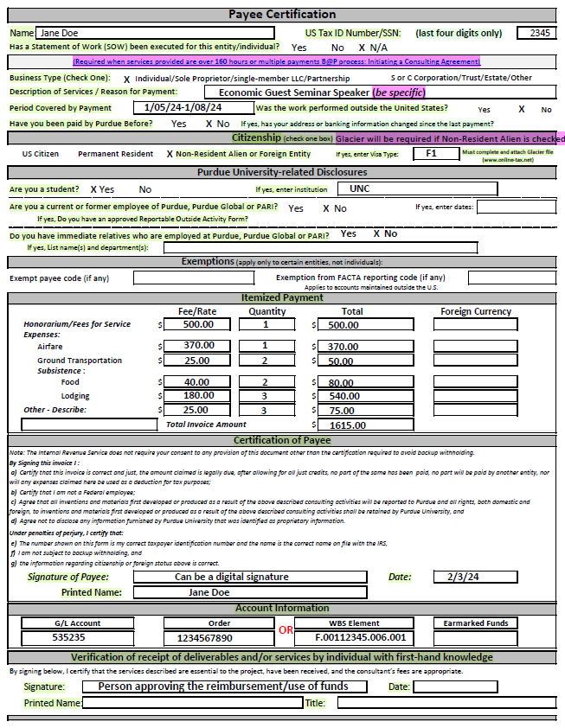
Business Office
Payee Certification (PC) Example

Slide 8

Business Office
Non-Employee Reimbursements
  Provide Receipts (proof of payment)
    All receipts must be submitted
    Receipts need to show last four digits of the card used to make the purchase
    If receipt does not show the last four digits, they can submit a bank statement (screenshot acceptable) showing the purchase.
      The statement needs to show the last four digits of the account
      All personal information should be blacked out
    If mileage is requested, Google Maps should be used to show the most direct route and calculated mileage.
      Double the mileage to show the roundtrip total and use that for the total reimbursement
        Mileage is currently reimbursed at the rate of 0.70
    Personal purchases that are 180 days or older from the date of the transaction noted on the proof of payment are no longer eligible for reimbursement.
      Any exceptions will be determined by DSB’s DFA.
  Provide statement of Purdue business purpose

Slide 9

Business Office
Non-Employee Reimbursements
International
  Glacier (Required)
    If the Non-Resident Alien or Foreign Entity box is checked in the Citizenship section, Glacier must be completed for tax purposes
    Notify the business office (busproc@purdue.edu) that you have a reimbursement for a Non-Resident Alien or Foreign Entity and request Glacier be initiated.
      Provide individual’s full legal name
      Provide the individual’s email
      If Purdue student, provide their PUID
        The PUID may be transmitted via email between Purdue business units.
          https://www.purdue.edu/securepurdue/identity-access/purdue-university-identification.php
    Notify the individual that they will receive an email from support@online-tax.net that needs to be completed before payment processing (Important to note: these emails can end up in the individual’s junk/spam folder)

Slide 10
Business Office
Non-Employee Reimbursement
International
  Glacier (cont)
    Confirmation will be sent back to the requestor that either Glacier has been initiated OR the individual already has a Glacier account.
      Once confirmation is received the requestor will need to email the recipient with the appropriate email template
      Please Note:
      The business office requests an automated email be sent to the individual but is not the sender of the Glacier email. (The Glacier email to non-employee comes from support@online-tax.net)
      Individual will need to provide I94, I20, Passport/Visa Stamp, and Tax Summary from Glacier (I20 and Tax Summary must be signed with a handwritten signature)
        These documents will be required with the reimbursement submission

Slide 11
Business Office
Non-Employee Reimbursements
International
  Glacier (cont)
  Email templates to inform Non-Employee regarding Glacier:
For recipient who DOES NOT have a Glacier account already:
“Recipient Name”, you should receive an email from support@online-tax.net (please be sure to check your spam/junk mail if you do not receive it in your regular email). The email will contain a temporary log in and password along with the information you need on how to log in.
You will need to select:
    Welcome: select “Create/update/view my Individual Record”
    Relationship: select “Sch. Liv Allow/Non-empl. Reimb/Prize/Award/HumSubj”
    Income Type: select “Scholar Liv Allow or Non-empl. Reimbursement”
(For Purdue Students)
  Please complete Glacier online, and you DO NOT need to submit any documents.
(For Non-Purdue Students and Guests)
  Please submit all required documents to “Admin Asst.’s Name” via Filelocker. DO NOT MAIL. An email from the Filelocker system will come shortly after this email. If you do not receive within the next half hour, please let me know and I can send you the link and password.

Slide 12
Busines Office
Non-Employee Reimbursements
International
  Glacier (cont)
  Email templates to inform Non-Employee regarding Glacier:
For someone who ALREADY HAS a Glacier account:
“Recipient Name”, It appears that you currently have a glacier account, so you will need to go in and complete a new document. If you do not remember your account information you will need to go to www. online-tax.net and click on “FORGOT Login”.
You’ll want to select the following:
    Welcome: select “Create/update/view my Individual Record”
    Relationship: select “Sch. Liv Allow/Non-empl. Reimb/Prize/Award/HumSubj”
    Income Type: select “Scholar Liv Allow or Non-empl. Reimbursement”
(For Purdue Students)
  Please complete Glacier online, and you DO NOT need to submit any documents.
(For Non-Purdue Students and Guests)
  Please submit all required documents to “Admin Asst.’s Name” via Filelocker. DO NOT MAIL. An email from the Filelocker system will come shortly after this email. If you do not receive within the next half hour, please let me know and I can send you the link and password.
  Additional guidance can be found on the Business Office Intranet page.

Slide 13

Business Office
Non-Employee Reimbursements
  Non-Employee’s Contact?
    As the approving area, you are the main contact for the individual being reimbursed
    Communication will be between you and this individual while your area will relay the information they provide to EOBOC via Team Dynamix (TDX)
      Make sure you are monitoring TDX for questions/status regarding the reimbursement
  Documents should be exchanged with EOBOC via TDX
Notes:
Program Manager/ person compiling forms should review before sending to the business ofifce

Slide 14

Business Office
Candidate Reimbursement
  Reimbursement to candidates are available for some travel expenses and prior approval is obtained via Form 17c process.
  Form 17C
    This One-Time Vendor process eliminates the need to set up new vendors with Payment Works.
    All submissions must include supporting documentation- Receipts/Proof of Payment.
Note:
  This process can be used for a non-employee in the capacity as a guest speaker. Provide more description for the “non-employee travel to Purdue for…” line (ie. Speaker/Dept/Reason)
  Honorariums/fee for services are taxable and cannot be processed in the One-Time Process.
  Reimbursements for prospective employees are tax-free
  If a Prospective Employee is International, they only need to complete Glacier if they bring a spouse/dependent. Tax considers this a taxable event and requires Glacier.
  Prospective Employee’s travel reimbursement is allowed as one-time payment only if they are not requesting reimbursement that includes another person traveling with them.
  Accounts Payable will process payments via check and ACH only; they will not process wire payments for One-Time Vendors.

Slide 15
Business Office
Candidate Reimbursement
Form 17c Fields
      Location – from and to, date traveled, and position they're interviewing for
Section A: Prospective Employee info and travel expenses
      If transportation expenses are Uber/Cab/Lyft rides, place under “Other Commercial Fare”
      For use of personal vehicle, place expense under “Private Vehicle”
    (note: SSN is only needed if spouse/dependent accompanied prospective employee)
Section B:
  A finalist (someone who has an extended offer) qualify for travel reimbursement for spouse/dependents.
      Complete if Spouse/Dependent accompanied prospective employee
  Any expenses reimbursed for spouse and/or dependents are taxable income to the prospective employee.
    Prospective employee travel reimbursements that include expenses for another person traveling with them must be paid via submission to EOBOC for processing of ZV60 document
      Payee Certification form is required when spouse/dependent travels with finalist.
    List Account Number and GL Code
    Travel expenses listed must match receipts. Receipts must show last four digits of card used for expense.
    Approval: Once form is completed, send via DocuSign to Adam Wilson to approve and sign on the For The President section.

Slide 16
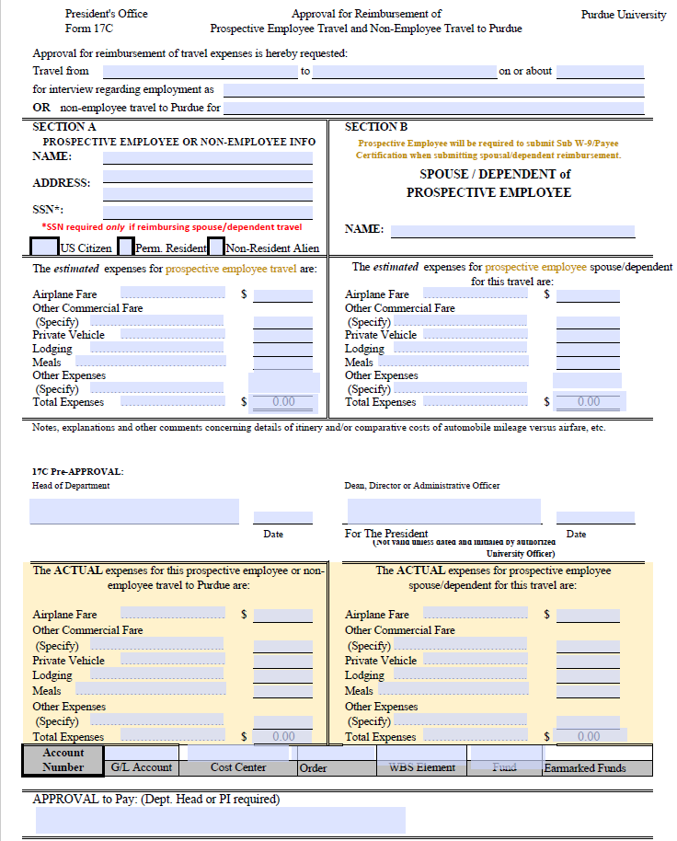
Business Office
Form 17C
Instructions for Preparing Form 17C
https://www.purdue.edu/hr/buspur/nonemppay/empreimb.php

Slide 17
Business Office
Candidate Reimbursement
  Receipts
    All receipts must be submitted
    Receipts need to show last four digits of the card used to make the purchase
    If receipt does not show the last four digits, they can submit a bank statement (screenshot acceptable) showing the purchase.
      The statement needs to show the last four digits of the account
      All personal information should be blacked out
    If mileage is requested, Google Maps should be used to show the most direct route and calculated mileage.
      Double the mileage to show the roundtrip total and use that for the total reimbursement
        Mileage is currently reimbursed at the rate of 0.70
    Unless specifically listed, expenses for prospective employees are reimbursed under the regulations governing normal employee reimbursement

Slide 18
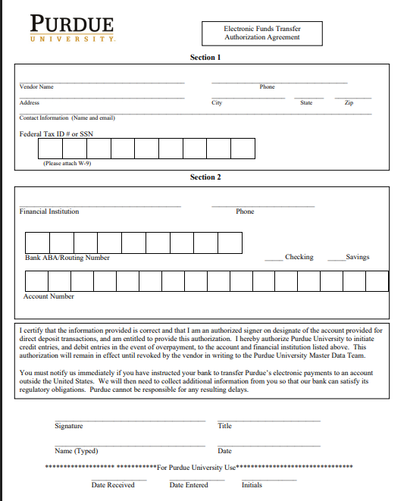
Business Office
Candidate Reimbursement
ACH Form
  Section 1:
    Provide complete name, address, phone & email
    Enter Tax ID (EIN or SSN) of the payee
  Section 2:
    Provide the name & phone number of the financial institution authorized to conduct transaction
    Enter the ABA/Routing # of the financial institution (9-digit number)
    Enter the account number
    Check appropriate box for ‘Checking’ or ‘Savings’
  An authorized signer on the bank account must sign this form
  Should not be submitted via DocuSign as the form contains restricted/sensitive data

Slide 19
Business Office
Candidate Reimbursement
Finalist Travel w/Spouse/Dependent
  Payee Certificate (PC)
    Completed by the Candidate
    Expenses noted on the form will only be the amounts incurred from the Spouse/Dependent
      This is considered the taxable portion
    Do NOT leave questions unanswered as incomplete forms will be rejected
    Candidate signature/printed name/date is required
    Account Information section
      The account # will either be an Order or WBS Element (not both)
  Signature required by the person/area approving the reimbursement
  Digital signature is allowed via DocuSign
    Should not be submitted via DocuSign with restricted/sensitive data

Slide 20
Business Office
Purdue Student Expenses
  Paying expenses on behalf of a student MUST be reported to DFA
    i.e. Booking airfare/hotel under the student’s name
    An email should be sent to the business office (busproc@purdue.edu) with the below information:
      PUID
      Student Name
      Total Amount
      Academic Term
      Reason for Payment
  Exception: If the expenses being reimbursed to a student are work related or part of a school Program (Is this a benefit for only the student or Purdue and the student?)

Slide 21
Business Office
Undergrad Purdue Paid Student
UG Students in a Paid Student Position Reimbursement Process
Ask the following questions:
  Have you been paid by Purdue before?
  Has anything changed since you were last paid by Purdue?
  Do you hold an active, paid UG student position?
    If the answer is yes…
      confirm they are active in SuccessFactors
      complete an Employee Reimbursement form and provide receipts showing proof of payment
The attached Reimbursement Decision Chart has been updated reflecting this revised guidance and has been added to the DSB Business Office Intranet page.

Slide 22

Business Office
Undergrad Purdue Paid Student
UG Students in a Paid Student Position Travel Reimbursement Process
UG students in an active UG student paid position should process travel reimbursement requests in Concur.
UG students should be directed to submit their travel expenses via Central Travel’s link to “Submit Travel Expenses” on their homepage.

Slide 23
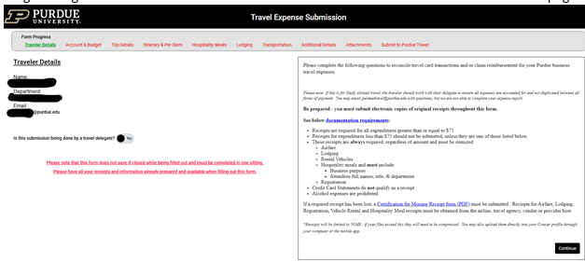
Business Office
Undergrad Purdue Paid Student
UG Students in a Paid Student Position Travel Reimbursement Process
They will log in using their Career Account Username and Password. Then will be directed to the next page for form completion.
If they have questions on completing the form, they should contact Central Travel at mailto:purduetravel@purdue.edu

Slide 24
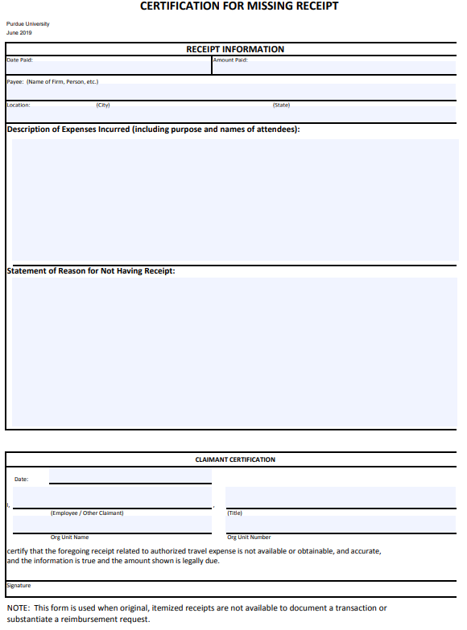
Business Office
Missing Receipt Form
If any expense does not have a receipt or it has been lost, a Missing Receipt form must be attached. https://www.purdue.edu/procurement/documents/missing-receipts.pdf

Slide 25
Business Office
Team Dynamix (TDX)
Reimbursements should be submitted via the ticket system: Team Dynamix (TDX)
Utilizing the formal ticket system promotes that all required information is provided in the initial request which should eliminate the need for follow-up questions that will only delay the process
Procurement Services available via TDX:
  Personal Reimbursements
  Invoice Payments
  Consulting Payments
  Placing orders
  Receipt of Goods
  General Inquiries regarding Purchasing
Resources for TDX can be found via the Service Portal (TDX) Resources website
  User Guide link

Slide 26
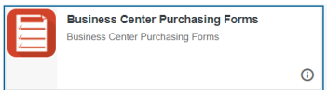
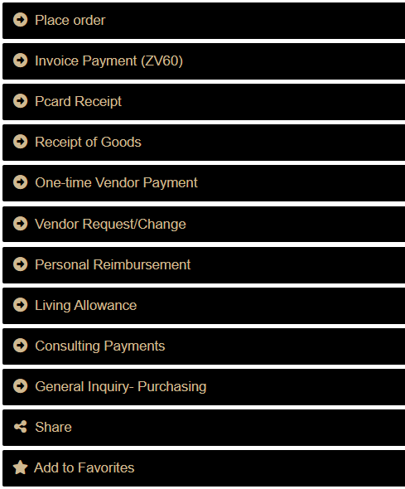
Business Office
Team Dynamix (TDX)
Submitting Ticket
Access TDX via their webpage OR OneCampus onepurdue.purdue.edu
Search “business center” to locate the link for Purchasing Center forms
Click the Business Center Purchasing Center Forms
4. Locate the service needed, then select the black box with gold text to initiate the form request
Paying vendor invoice
Form 17c process
PaymentWorks Requests
Employee/Non-Employee Reimbursements
General Questions

Slide 27
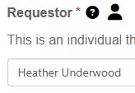

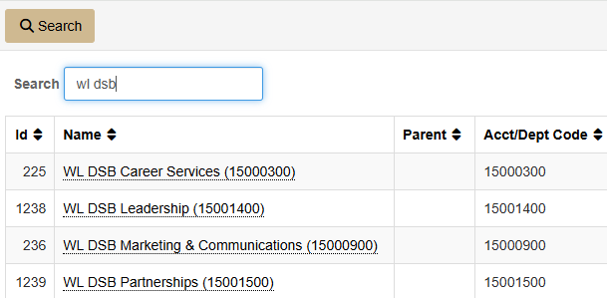
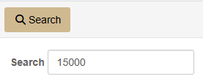
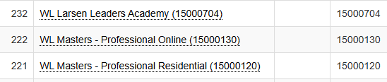
Business Office
Team Dynamix (TDX)
Submitting Ticket cont
5. On each specific form, the requestor name should auto-populate from the user sign in
6. Acct/Dept field is a required field that must be selected in order to move forward
  In the Acct/Dept field, you can start typing WL DSB and it will provide DSB areas options.
  This field ensures the request is delivered to the appropriate Procurement Center
  Customers can use the magnifying glass to aid in search- either enter a department name or responsible cost center number

Slide 28

Business Office
Team Dynamix (TDX)
Submitting Ticket cont
7. Please Note: all fields will have a black circle with a ? icon . When selecting, a text language will appear that will explain in additional guidance on completing this portion of the request.
8. Be sure to complete all RED asterisk (*) to formally submit each request.
9. Be sure to attach supporting documentation where relevant and provide justification for all requests to allow for a smoother process.
10. When finished, submit via the gold “Submit” button.
11. Once successfully submitted, the requestor submitting the request will receive an email response providing a link to easy access back to the ticket queue for tickets submitted.
12. The respective service center will receive and process the request and will communicate to the requestor via the system.

Slide 29

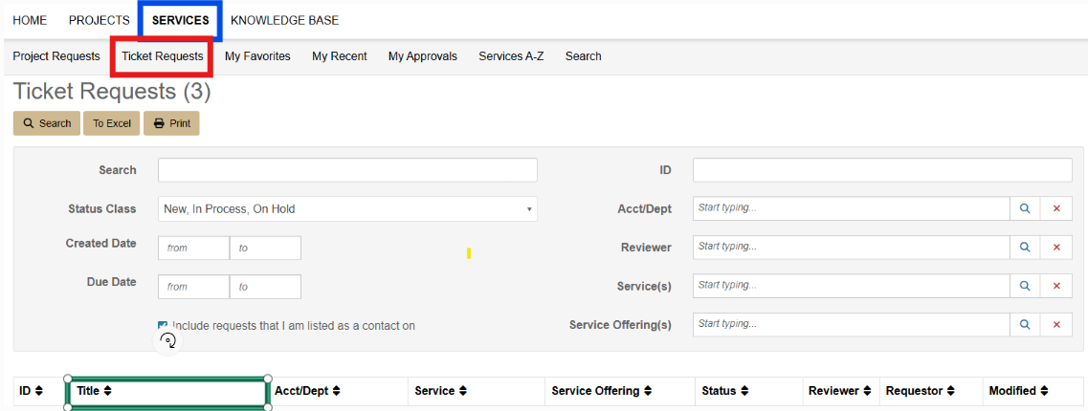
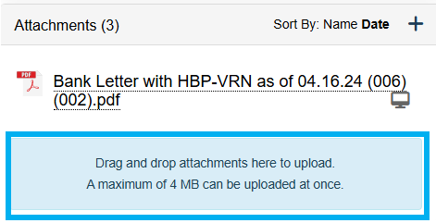
Business Office
Team Dynamix (TDX)
Submitting Ticket cont
13. Attachments can be loaded from the “browse” feature of the form.
If the file is too large, an error will be displayed and there are 2 additional options for submitting an attachment
  Option 1: Reply to the email confirmation/ticket you receive; attach the file and send via email
  Option 2: Login to service.purdue.edu
    Click “Services” in the top banner
    Select “Ticket Requests” from
    the sub-banner on the next page
    Scroll down and navigate to
    the applicable ticket
    Click the ticket title
    Locate the attachments box on the right of screen
    Drag & Drop the file needing to be attached

Slide 30

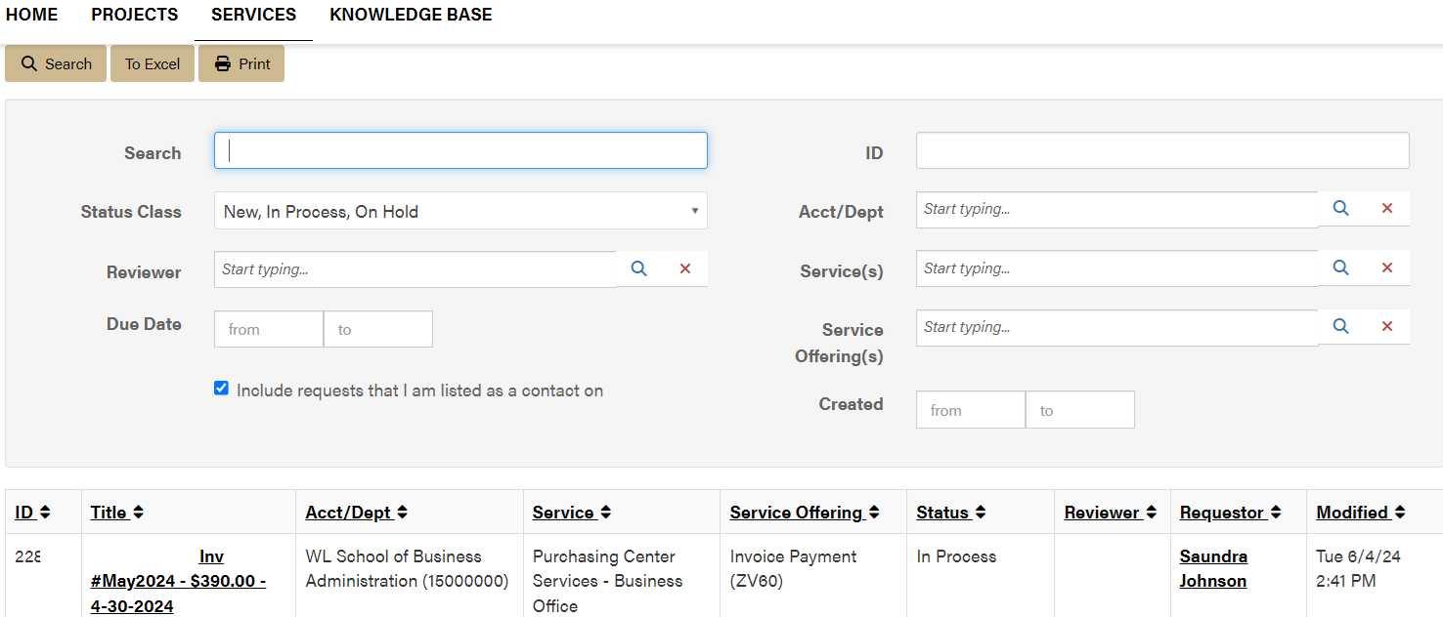
Business Office
Team Dynamix (TDX)
How to Access Previously Submitted Tickets
1. Once a service request is submitted, ticket requests can be monitored by the requestor by logging into the service.purdue.edu and visiting “Ticket Requests”
2. After selecting Ticket Requests, the next screen will provide a search function but also a list of service requests submitted by the end user OR the contact if one has been added to the request.
  There is also search function to quickly find a specific request

Slide 31



Business Office
Team Dynamix (TDX) FAQs
Is there an easier way to access service requests?
  Yes. Once familiar with using Purchasing Center Services – Business Office a “My Favorites” link can be added for quicker access in placing service requests which will populate a favorite list on the main service tool bar.
Can I send restricted & sensitive information through the TDX forms?
  Yes, TDX meets Purdue’s security requirements for protected data as it requires authentication through the Boiler Key system.
I don’t see a service request form that fits my need. What do I do??
  If you are submitting a Procurement request, use the General Inquiry-Purchasing form.

Slide 32

Business Office
Why is my document being rejected?
  Forms completed in different ink colors
  Description of Services/Reason for Payment on PC form left blank or too vague (be specific)
  No answer to “Have you been paid by Purdue Before” on PC form
  Missing signatures
  Signatures are in wrong fields
  Reimbursement amount is not provided on PC form
  Checking or Savings not marked
  Address has changed since last payment/for both the Employee and Non-Employee

Slide 33
Business Office
Why is my document being rejected?
Continued...
  Account not provided
  GL code not provided
  Last 4 digits of the Tax ID field on the PC form is blank
  Citizenship is not provided
  Type of business is left blank
  SOW question is not answered on PC form
  Employee address must match address in Success Factors
    All contact information must match what is currently on file
  Employee/Non-Employee banking information does not match PaymentWorks
  Vendor’s W9 address does not match PaymentWorks (Process a “Vendor request/change”)

Slide 34
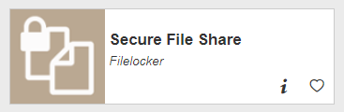
Business Office
How to use FileLocker
  Documents should be exchanged between the Non-Employee and Guests via FileLocker due to the sensitive information being provided
    To request documents be sent via FileLocker from a Non-Employee and Guests, a link will need to be sent to them via FileLocker in order for them to upload their documents
      Click “Request Upload” tab in FileLocker
        For a single upload, enter the person’s email and click “Create Request”
        For multiple uploads, click on all boxes, create a password and click “Create Request”
    There are further instructions located on the Business Office Intranet page within the Glacier Process document
    Helpful “How to” use Filelocker

Slide 35
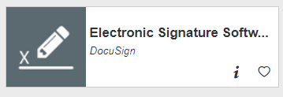

Business Office
How to use DocuSign
Helpful “How to” use DocuSign
  For Signers
  For Senders
    https://www.itap.purdue.edu/services/docusign.html
Reminder: Should not submit documents via DocuSign containing restricted/sensitive data

Slide 36

Business Office
GL List
GL is the code describing the type of expense
Need to use the common GL list provided by the business office
  Found on Business Office Intranet page
If unsure of what GL code to use, please contact the business office

Slide 37
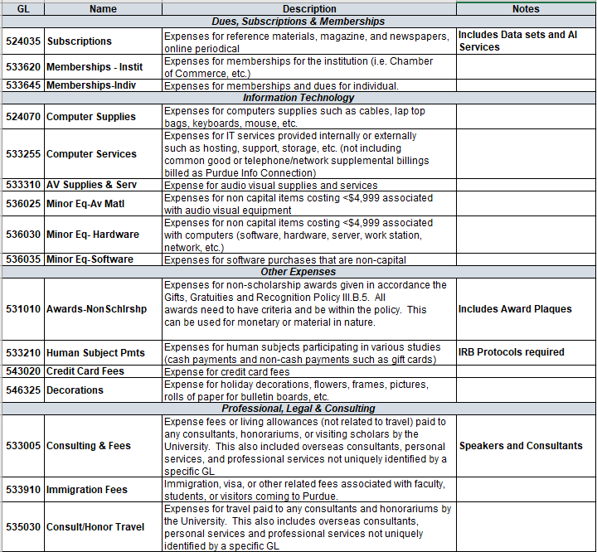
Business Office
Common GL List

Slide 38
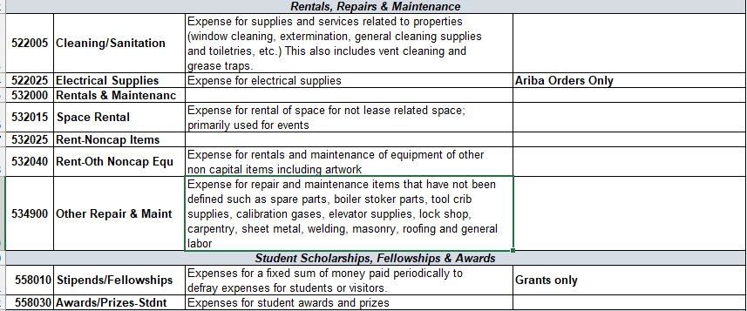
Business Office
Common GL List continued

Slide 39
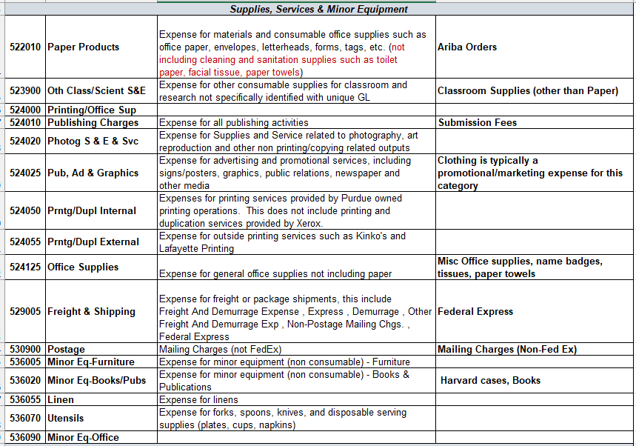
Business Office
Common GL List continued

Slide 40
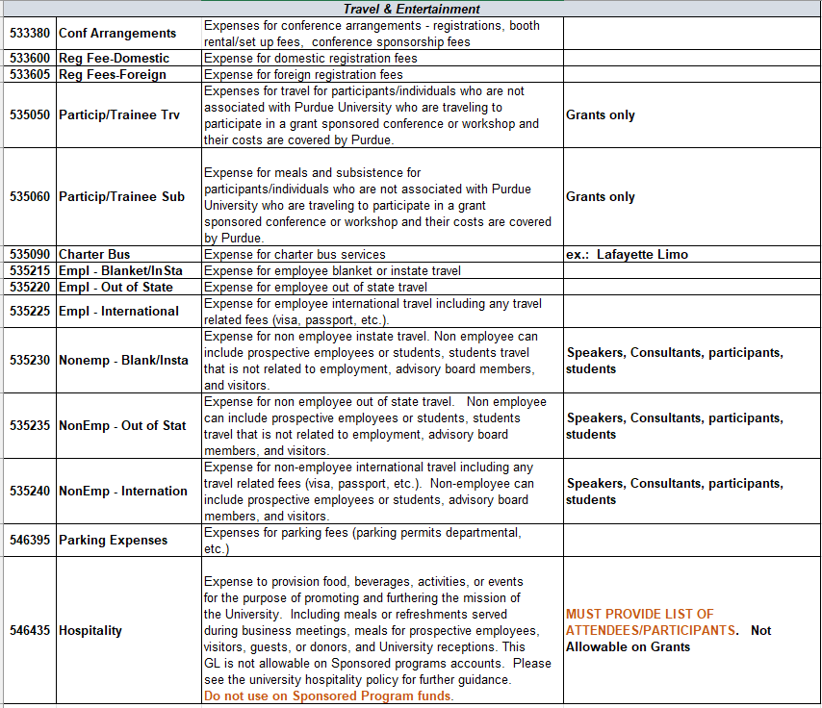
Business Office
Common GL List continued

Slide 41

Business Office
Tips & Tricks
Review every section of the forms before submitting to EOBOC via TDX. Once they send it back with errors to be fixed it delays reimbursement payment.
When submitting Hospitality expenses, please place in the Comments section of TDX the Business Purpose
EOBOC would like the forms put together in this order in PDF Format: Payee Cert, Receipts, and E-mail (Glacier if applicable).
Once ticket status notification is sent from EOBOC noted as “Complete,” this means EOBOC Center’s portion is complete.
ANYONE HAVE HELPFUL “TIPS & TRICKS” TO SHARE?

Slide 42

Contact Information
EOBOC Procurement:
  procureeo@purdue.edu
    If using email to contact EOBOC Procurement, please note a new ticket number is generated.
    If email is referencing an established ticket, preference is for replies to come from TDX ticket number.
General Business Office:
  busproc@purdue.edu

Slide 43
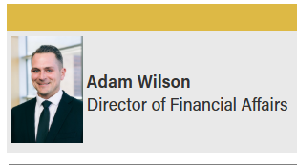
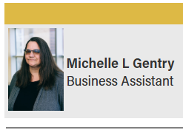

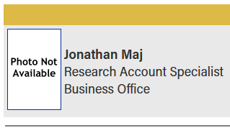
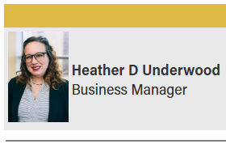
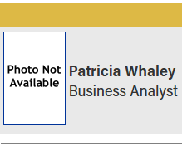

Business Office Team

Slide 44

Business Office
Any Questions?

Slide 45

Business Office

