Slide 1
Business Office Reimbursement Process

Slide 2
Business Office
Decision Chart
Reimbursements
Employee
Non-Employee
Candidate
Purdue Students
Team Dynamix Information
Forms Rejected, WHY??
FileLocker
DocuSign
GL List
Tips & Tricks
Contacts

Slide 3
Business Office
Employee Decision Chart
Are you assisting an employee or non-employee?
Employee
Required Documents: 1) Employee Reimbursement Form 2) Receipts
Has anything changed? (i.e. address)
Yes- Address will need to be updated in Success Factors (SF)
No- Continue with 2 required documents

Slide 4
Business Office
Non-Employee Decision Chart
Are you assisting an employee or non-employee?
Non-Employee
Have you been paid by Purdue before?
Has anything changed since you were paid last time by Purdue? (i.e. address, bank information)
Yes
Required Document: Payee Certification (PC) form
Yes
No
Required Documents: 1) Payee Certification (PC) form
2) Substitute W9

Slide 5
Business Office
Non-Employee Decision Chart
Are you assisting an employee or non-employee?
Non-Employee
Have you been paid by Purdue before?
Once the individual has completed Glacier requirements, they will need to provide Glacier documents to finalize the reimbursement packet
No
Required Documents 1) Payee Certification (PC) form 2) Substitute W9 3) Receipts (if applicable)
What is the Citizenship status on the PC form: Citizen, Permanent Resident, Non-Resident Alien or Foreign Entity?
Non-Resident Alien or Foreign Entity
Glacier Documents required: Email Sandy Johnson to request initiation of Glacier
An email will be sent to the individual providing instructions regarding how to complete Glacier from support@online-tax.net

Slide 6
Business Office
Non-Employee Decision Chart
Are you assisting an employee or non-employee?
Non-Employee
Have you been paid by Purdue before?
Regular Required Documents
No
Required Documents 1) Payee Certification (PC) form 2) Substitute W9 3) Receipts (if applicable)
What is the Citizenship status on the PC form: Citizen, Permanent Resident, Non-Resident Alien or Foreign Entity?
Citizen or Permanent Resident

Slide 7
Business Office
Non Employee Travel Reimbursement Decision Chart
Is this ONLY for travel reimbursement to a Non Employee?
Yes, Can be processed as a One Time Payment
Required Documents:
1) Form 17C
2) ACH Form
3) Payee Certification (PC) form
4) Substitute W9
5) Original Receipts
No, go to previous 4 Non Employee Decision Charts

Slide 8
Business Office
Prospective Employee Decision Chart
Did the prospective employee/candidate attend alone?
No, a spouse/dependent attended with them
Required Documents:
1) Form 17C
2) ACH Form
3) Payee Certification (PC) form
4) Substitute W9
5) Original Receipts
Yes
Required Documents:
1) Form 17C
2) ACH Form

Slide 9
Business Office
Student Decision Chart
Are you assisting a Purdue UG student?
Yes
Contact Karin Disher with the below information:
1) Student Name
2) Student Email
3) Reason for Payment
4) Account Number
5) Approval Email from Faculty Member
6) Receipt/Proof of Payment
Citizen
Is the reimbursement work related?
No
Is the student a Non Resident Alien or Citizen?

Slide 10
Business Office
Student Decision Chart
Are you assisting a Purdue UG student?
Yes
Notify student: Will need to complete Glacier but will NOT submit any documents (email will be from support@online-tax.net)
Non Resident Alien
Is the reimbursement work related?
No
Is the student a Non Resident Alien or Citizen?
Email Sandy Johnson
1)Student Name
2) Request for Glacier
Sandy will provide confirmation that Glacier submitted
Contact Karin Disher with the below information:
1) Student Name
2) Student Email
3) Reason for Payment
4) Account Number
5) Approval Email from Faculty Member
6) Confirmation Glacier Sent
7) Receipt/Proof of Payment

Slide 11
Business Office
Student Decision Chart
Are you assisting a Purdue UG student?
Yes
Submit under the standard reimbursement process. (This includes completion of a Payee Certificate and Sub W9)
Is the reimbursement work related?
Yes

Slide 12
Business Office
Student Decision Chart
Are you assisting a Purdue Masters student?
Yes
Direct student to William A Robbins III
William will follow previous decision charts

Slide 13
Business Office
Student Decision Chart
Are you assisting a Purdue Doctoral student?
Yes
Direct student to Quintin Martin (mart1128@purdue.edu)
Quintin will follow previous decision charts

Slide 14
Business Office
Reimbursements
Employee
Required documents will be submitted via Team Dynamics (TDX)
Complete Employee Reimbursement Form
Employee requesting the reimbursement should complete
Account number and signature required by the person approving the reimbursement
Requesting area will complete the form’s bottom portion

Slide 15
Business Office
Reimbursements
Employee
Provide Receipts (proof of payment)
All receipts must be submitted
Receipts should be itemized especially for Hospitality
Receipts need to show last four digits of the card used to make the purchase
If receipt does not show the last four digits, a bank statement can be submitted (screenshot acceptable) showing the purchase.
The statement needs to show the last four digits of the card
All personal information should be blacked out
If mileage is requested, a Google Map can be submitted showing their route and calculated mileage.
Double the mileage to show the roundtrip total and use that for the total reimbursement
Mileage is currently reimbursed at the rate of 0.67

Slide 16
Business Office
Reimbursements
Non-Employee
The following documents are required for processing and will be submitted via TDX:
Payee Certificate (PC)
Completed by the person requesting the reimbursement
Account number and Signature required by the person/area approving the reimbursement
This form must have these items completed
SSN Last 4 digits
Business Type
Reason for Payment
Citizenship Type
PU-related Disclosures section
Itemized Payment section
Digital signature is allowed via DocuSign
To initiate via DocuSign link
Account Information section
The account # will either be an Order or WBS Element (not both)

Slide 17
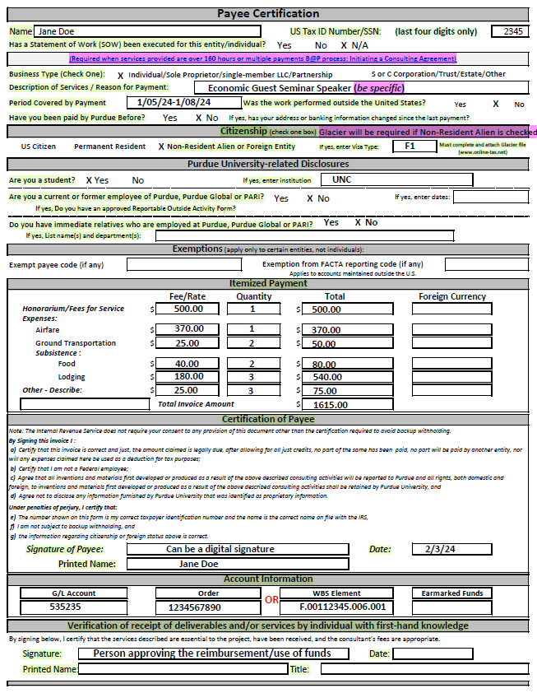
Business Office
Payee Certification (PC) Example

Slide 18
Business Office
Reimbursements
Non-Employee
Substitute W-9
Completed by the person requesting the reimbursement
This form must have these items completed
SSN/TIN (Full)
Email (especially if Glacier is needed)
Address
Telephone Number
Business Type
Citizenship
Purdue University-related Disclosures
Payment Method
Direct Deposit
Checking or Savings
Please inform individual Procurement will be contacting them to verify banking information
Paper Check
Effective 10/1/23: Digital signature is allowed but NOT via Purdue’s DocuSign

Slide 19
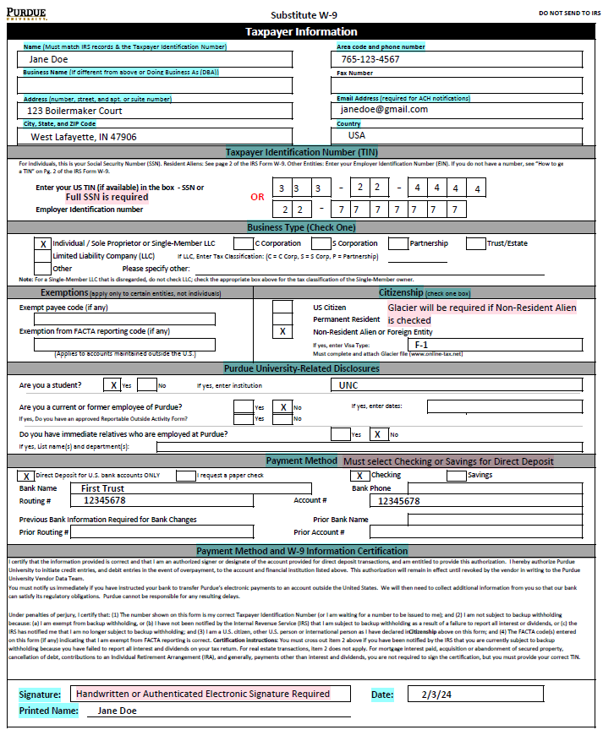
Business Office
Substitute W9 Example

Slide 20
Business Office
Reimbursements
Non-Employee
Glacier
If the Non-Resident Alien or Foreign Entity box is checked in the Citizenship section, Glacier must be completed for tax purposes
Notify the individual that they will receive an email from support@online-tax.net that needs to be completed before payment processing (Important to note: these emails can end up in the individual’s junk/spam folder)
Notify the business office (busproc@purdue.edu) that you have a reimbursement for a Non-Resident Alien or Foreign Entity.
Provide the individual’s email
If Purdue student, provide their PUID (sensitive information-send via FileLocker)
The business office requests an automated email be sent to the individual but is not the sender of the Glacier email. (The Glacier email to non-employee comes from support@online-tax.net)
Individual will need to provide I94, I20, Passport/Visa Stamp, and Tax Summary from Glacier (I20 and Tax Summary must be signed with a handwritten signature)
These documents will be required with the reimbursement submission
The student is provided 30 days to complete Glacier packet in order to be paid
The student should provide Glacier documents 5 days prior to the 5/31 deadline for payment to be processed in academic year awarded

Slide 21
Business Office
Reimbursements
Non-Employee
Glacier cont
Email templates to inform Non-Employee regarding Glacier:
For someone who DOES NOT have a Glacier account already:
“Recipient Name”, you should receive an email from support@online-tax.net (please be sure to check your spam/junk mail if you do not receive it in your regular email). The email will contain a temporary log in and password along with the information you need on how to log in. You will need to select:
Sch Liv Allow/Non-empl. Reimb/Prize/Award/HumSubj
When you get to the screen regarding SSN, if you do not have one please select “I do NOT have a US-issued SSN or ITIN; I would like to apply for an SSN”
By selecting this it will allow you to continue. You do not need to apply for an SSN for this payment.
For someone who ALREADY HAS a Glacier account:
“Recipient Name”, It appears that you currently have a glacier account, so you will need to go in and complete a new document. If you do not remember your account information you will need to go to www. online-tax.net and click on “FORGOT Login”. You’ll want to select the following:
Welcome: select “Create/update/view my Individual Record”
Relationship: select “Sch. Liv Allow/Non-empl. Reimb/Prize/Award/HumSubj”
Income Type: select “Scholar Liv Allow or Non-empl. Reimbursement”
Additional guidance can be found on the Business Office Intranet page.

Slide 22
Business Office
Reimbursements
Non-Employee
Receipts
All receipts must be submitted
Receipts should be itemized especially for Hospitality
Receipts need to show last four digits of the card used to make the purchase
If receipt does not show the last four digits, they can submit a bank statement (screenshot acceptable) showing the purchase.
The statement needs to show the last four digits of the card
All personal information should be blacked out
If mileage is requested, they can submit a Google Map showing their route and calculated mileage.
Double the mileage to show the roundtrip total and use that for the total reimbursement
Mileage is currently reimbursed at the rate of 0.67

Slide 23
Business Office
Reimbursements
Non-Employee
Non-Employee’s Contact?
As the approving area, you are the main contact for the individual being reimbursed
Communication will be between you and this individual while your area will relay the information they provide to EOBOC via Team Dynamix (TDX)
Make sure you are monitoring TDX for questions/status regarding the reimbursement
Reminder: Please make sure the non-employee’s email is listed on the Substitute W-9
Documents should be exchanged with EOBOC via TDX
Notes:
Program Manager/ person compiling forms should review before sending to the business ofifce

Slide 24
Business Office
Candidate Reimbursement
The following documents are required for processing, if candidate attends alone:
Form 17C
Location – to and from, date traveled, and position they're interviewing for
Section A: Prospective Employee info and travel expenses (note: SSN is only needed if spouse/dependent accompanied prospective employee)
Section B: Complete if Spouse/Dependent accompanied prospective employee
If a Prospective Employee is International, they only need to complete Glacier if they bring a spouse/dependent. Tax considers this a taxable event and requires Glacier.
List Account Number and GL Code
Travel expenses listed must match receipts. Receipts must show last four digits of card used for expense.
Approval: Once form is completed, send via DocuSign to Adam Wilson to approve and sign in the (For The President) section.
Instructions for Preparing Form 17C
https://www.purdue.edu/hr/buspur/nonemppay/empreimb.php

Slide 25
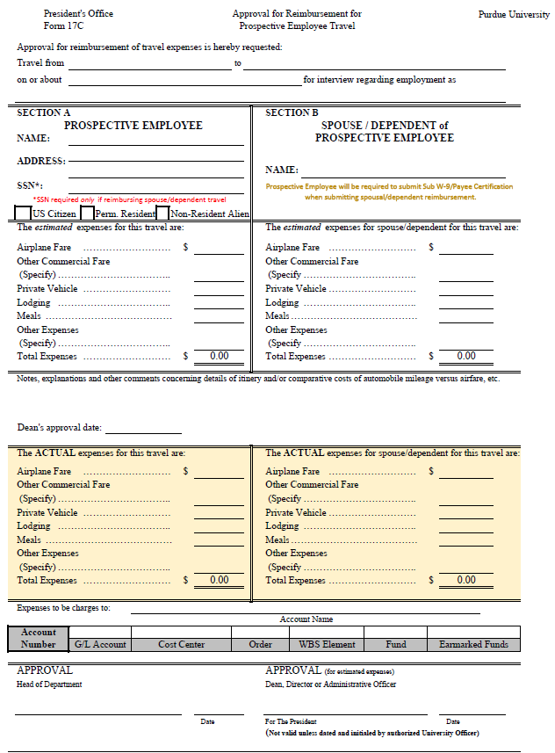
Business Office
Form 17C

Slide 26
Business Office
Candidate Reimbursement
ACH Form
Section 1:
Provide complete name, address, phone & email
Enter Tax ID (EIN or SNN) of the payee
If Change, must provide banking information currently on file at Purdue
Section 2:
Provide the name & phone number of the financial institution authorized to conduct transaction
Enter the ABA/routing # of the financial institution (9-digit number)
Enter the account number
Check appropriate box for ‘Checking’ or ‘Savings’
An authorized signer on the bank account must sign this form

Slide 27
Business Office
Candidate Reimbursement
Receipts
All receipts must be submitted
Receipts need to show last four digits of the card used to make the purchase
If receipt does not show the last four digits, they can submit a bank statement (screenshot acceptable) showing the purchase.
The statement needs to show the last four digits of the card
All personal information should be blacked out
If mileage is requested, they can submit a Google Map showing their route and calculated mileage.
Double the mileage to show the roundtrip total and use that for the total reimbursement
Mileage is currently reimbursed at the rate of 0.67
Unless specifically listed, expenses for prospective employees are reimbursed under the regulations governing normal employee reimbursement

Slide 28
Business Office
Candidate Reimbursement
The following documents are required for processing, if candidate attends as a Finalist with Spouse/Dependent:
Form 17C
Location – to and from, date traveled, and position they're interviewing for
Section A: Prospective Employee info and travel expenses (note: SSN is only needed if spouse/dependent accompanied prospective employee)
Section B: Complete if Spouse/Dependent accompanied prospective employee
If a Prospective Employee is International, they only need to complete Glacier if they bring a spouse/dependent. Tax considers this a taxable event and requires Glacier.
List Account number and GL Code
Travel expenses listed must match receipts. Receipts must show last four digits of card used for expense.
Approval: Once form is completed, send via DocuSign to Adam Wilson to approve and sign in the (For The President) section.
Instructions for Preparing Form 17C
https://www.purdue.edu/hr/buspur/nonemppay/empreimb.php

Slide 29
Business Office
Candidate Reimbursement
ACH Form
Section 1:
Check the appropriate box for ‘New’ or ‘Change’
Provide complete name, address, phone & email
Enter Tax ID (EIN or SNN) of the payee
If Change, must provide banking information currently on file at Purdue
Section 2:
Provide the name & phone number of the financial institution authorized to conduct transaction
Enter the ABA/routing # of the financial institution (9-digit number)
Enter the account number
Check appropriate box for ‘Checking’ or ‘Savings’
An authorized signer on the bank account must sign this form

Slide 30
Business Office
Candidate Reimbursement
Receipts
All receipts must be submitted
Receipts need to show last four digits of the card used to make the purchase
If receipt does not show the last four digits, they can submit a bank statement (screenshot acceptable) showing the purchase.
The statement needs to show the last four digits of the card
All personal information should be blacked out
If mileage is requested, they can submit a Google Map showing their route and calculated mileage.
Double the mileage to show the roundtrip total and use that for the total reimbursement
Mileage is currently reimbursed at the rate of 0.67
Unless specifically listed, expenses for prospective employees are reimbursed under the regulations governing normal employee reimbursement

Slide 31
Business Office
Candidate Reimbursement
Payee Certificate (PC)
Completed by the Candidate
Expenses noted on the form will only be the amounts incurred from the Spouse/Dependent
This is considered the taxable portion
Account number and Signature required by the person/area approving the reimbursement
This form must have these items completed
SSN Last 4 digits
Business Type
Reason for Payment
Citizenship Type
PU-related Disclosures section
Itemized Payment section
Digital signature is allowed via DocuSign
Account Information section
The account # will either be an Order or WBS Element (not both)

Slide 32
Business Office
Candidate Reimbursement
Substitute W-9
Completed by the Candidate
This form must have these items completed
SSN/TIN (Full)
Email (especially if Glacier is needed)
Address
Telephone Number
Business Type
Citizenship
Purdue University-related Disclosures
Payment Method
Direct Deposit
Checking or Savings
Please inform the individual Procurement will be contacting them to verify banking information
Paper Check
Effective 10/1/23: Digital signature is allowed but NOT via Purdue’s DocuSign

Slide 33
Business Office
Purdue Student Expenses
Paying expenses on behalf of a student MUST be reported to DFA
i.e. Booking airfare/hotel under the student’s name
An email should be sent to the business office (busproc@purdue.edu) with the below information:
PUID
Student Name
Total Amount
Academic Term
Reason for Payment
Exception: If the expenses being reimbursed to a student are work related or part of a school Program (Is this a benefit for only the student or Purdue and the student?)

Slide 34
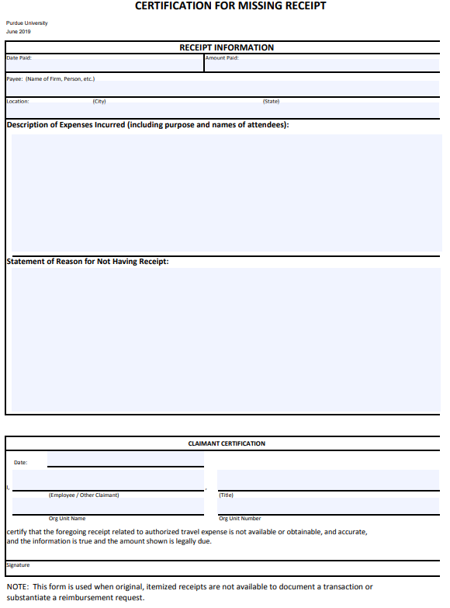
Business Office
Missing Receipt Form
If any expense does not have a receipt or it has been lost, a Missing Receipt form must be attached. https://www.purdue.edu/procurement/documents/missing-receipts.pdf

Slide 35
Business Office
Team Dynamix (TDX)
Reimbursements should be submitted via the new ticket system: Team Dynamix (TDX)
Utilizing the formal ticket system promotes that all required information is provided in the initial request which should eliminate the need for follow-up questions that only delay the process
Procurement Services available via TDX:
Personal Reimbursements
Invoice Payments
Consulting Payments
Placing orders
Receipt of Goods
General Inquiries regarding Purchasing
Resources for TDX can be found via the Service Portal (TDX) Resources website
User Guide link

Slide 36
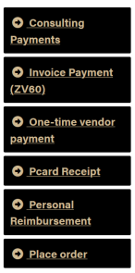
Business Office
Team Dynamix (TDX)
Submitting Ticket
Access TDX via their webpage OR OneCampus onepurdue.purdue.edu
Search “business center” to locate the link for Purchasing Center forms
Click the Business Center Purchasing Center Forms
4. Locate the service needed, then select the black box with gold text to initiate the form request

Slide 37
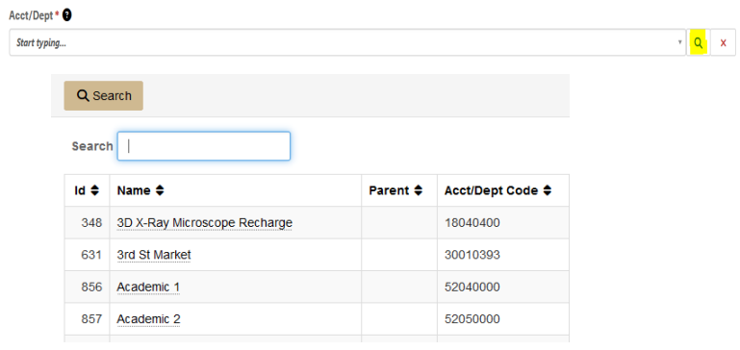
Business Office
Team Dynamix (TDX)
Submitting Ticket cont
5. On each specific form, the requestor name should auto-populate from the user sign in
6. Acct/Dept field is a required field that must be selected in order to move forward
In the Acct/Dept field, you can start typing WL School of Business Administration and it will auto fill for you.
This field ensures the request is delivered to the appropriate Procurement Center
Customers can use the magnifying glass to aid in search- either enter a department name or responsible cost center number

Slide 38
Business Office
Team Dynamix (TDX)
Submitting Ticket cont
7. Please Note: All fields will have a black circle with a ? icon . When selecting, a text language will appear that will explain in additional guidance on completing this portion of the request.
8. In the “Tell us about your request” be sure to complete all RED asterisk (*) to formally submit each request.
9. Be sure to attach supporting documentation where relevant and provide justification for all requests to allow for a smoother process.
10. When finished, submit via the gold “Submit” button.
11. Once successfully submitted, the requestor submitting the request will receive an email response providing a link to easy access back to the ticket queue for tickets already submitted.
12. The respective service center will receive and handle the request and will communicate to the requestor via the system.

Slide 39
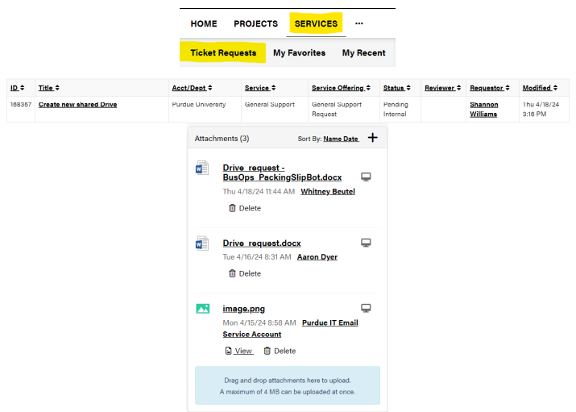
Business Office
Team Dynamix (TDX)
Submitting Ticket cont
13. Attachments can be loaded from the “browse” feature of the form.
If the file is too large, an error will be displayed and there are 2 additional options for submitting an attachment
Option 1: Reply to the email confirmation/ticket you receive; attach the file and send via email
Option 2: Login to service.purdue.edu
Click “Services” in the top banner
Select “Ticket Requests” from the sub-banner
on the next page
Scroll down and navigate to the applicable ticket
Click the ticket title
Locate the attachments box on the right of screen
Drag & Drop the file needing to be attached

Slide 40
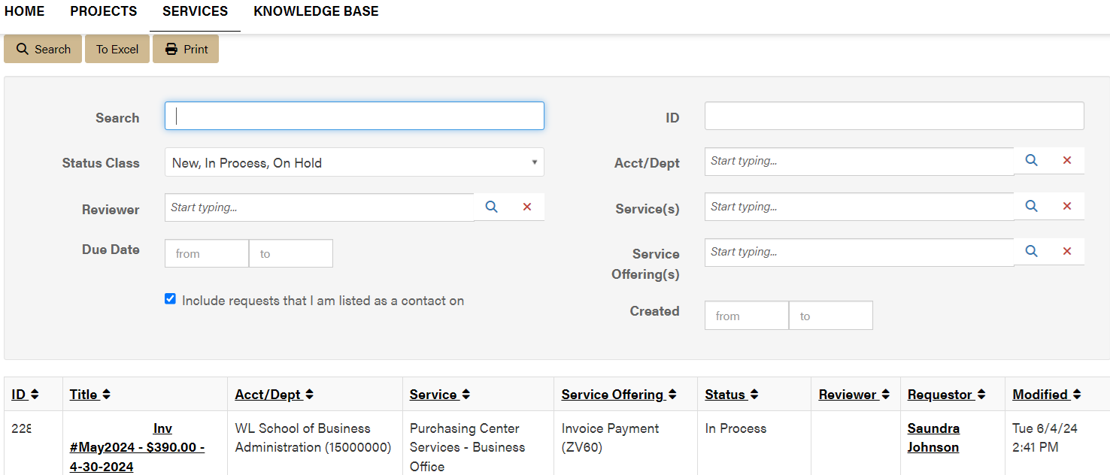
Business Office
Team Dynamix (TDX)
How to Access Previously Submitted Tickets
1. Once a service request is submitted, ticket requests can be monitored by the requestor by logging into the service.purdue.edu and visiting “Ticket Requests.”
2. After selecting Ticket Requests, the next screen will provide a search function but also a list of service requests submitted by the end user OR the contact if added to the request.
There is also search function to quickly find a specific request

Slide 41
Business Office
Team Dynamix (TDX) FAQs
Is there an easier way to access service requests?
Yes. Once familiar with using Purchasing Center Services – Business Office a “My Favorites” link can be added for quicker access in placing service requests which will populate a favorite list on the main service tool bar.
Can I send restricted & sensitive information through the TDX forms?
Yes, TDX meets Purdue’s security requirements for protected data as it requires authentication through the Boiler Key system.

Slide 42
Business Office
Why is my document being rejected?
Forms completed in different ink colors
Description of Services/Reason for Payment on PC form left blank or too vague (be specific)
No answer to “Have you been paid by Purdue Before” on PC form
Missing signatures
Non-authenticated electronic signature on Sub W9
DocuSign was not used for Digital Signature
on PC From
Signatures are in wrong fields
Reimbursement amount is not provided on PC form
Checking or Savings not marked
Address has changed since last payment/for both the Employee and Non-Employee

Slide 43
Business Office
Why is my document being rejected?
Continued...
Account not provided
GL code not provided
Last 4 digits of the Tax ID field on the PC form is blank
Tax ID should be formatted either XXX-XX-XXXX or XX-XXXXXXX on Sub W9
Citizenship is not provided
Type of business is left blank
SOW question is not answered on PC form
EOBOC couldn’t reach individual to verify banking info (Verbal verification is required)
Employee address must match address in Success Factors
All contact information must match what is currently on file

Slide 44
Business Office
How to use FileLocker
Documents should be exchanged between the Non-Employee and Guests via FileLocker due to the sensitive information being provided
To request documents be sent via FileLocker from a Non-Employee and Guests, a link will need to be sent to them via FileLocker in order for them to upload their documents
Click “Request Upload” tab in FileLocker
For a single upload, enter the person’s email and click “Create Request”
For multiple uploads, click on all boxes, create a password and click “Create Request”
There are further instructions located on the Business Office Intranet page within the Glacier Process document
Helpful “How to” use Filelocker

Slide 45
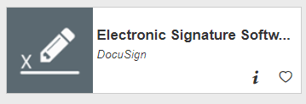
Business Office
How to use DocuSign
Helpful “How to” use DocuSign
For Signers
For Senders
https://www.itap.purdue.edu/services/docusign.html

Slide 46
Business Office
GL (General Ledger) List
GL is the code describing the type of expense
Need to use the common GL list provided by the business office
Found on Business Office Intranet page
If unsure of what GL code to use, please contact the business office

Slide 47
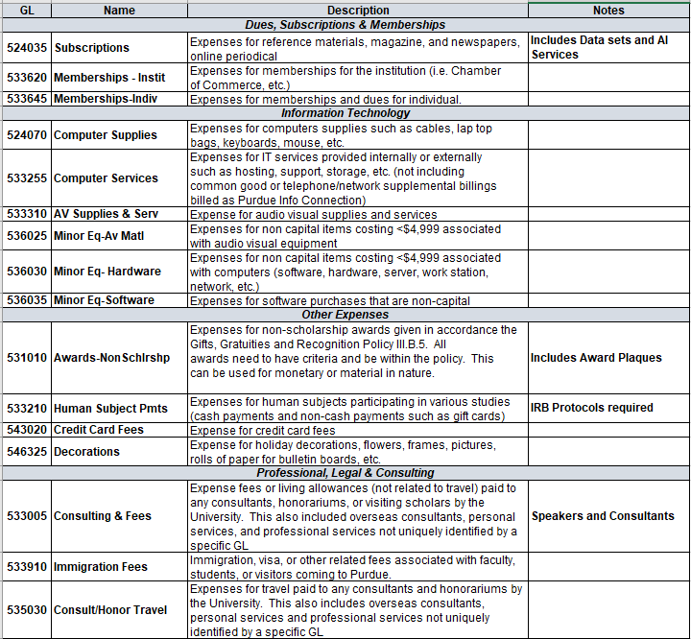
Business Office
Common GL List

Slide 48
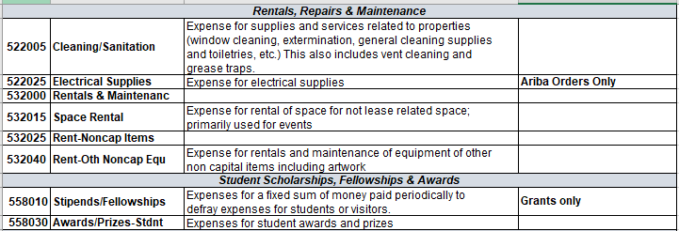
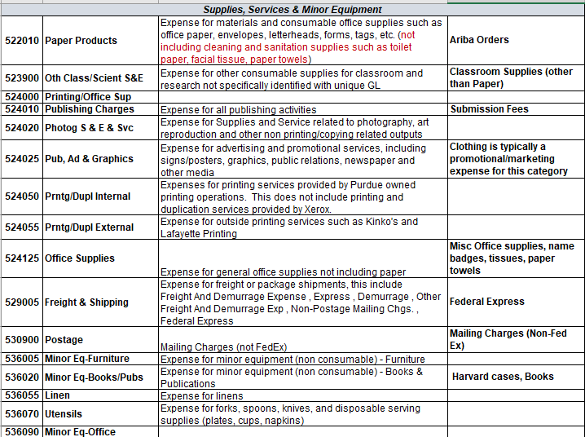
Business Office
Common GL List continued

Slide 49
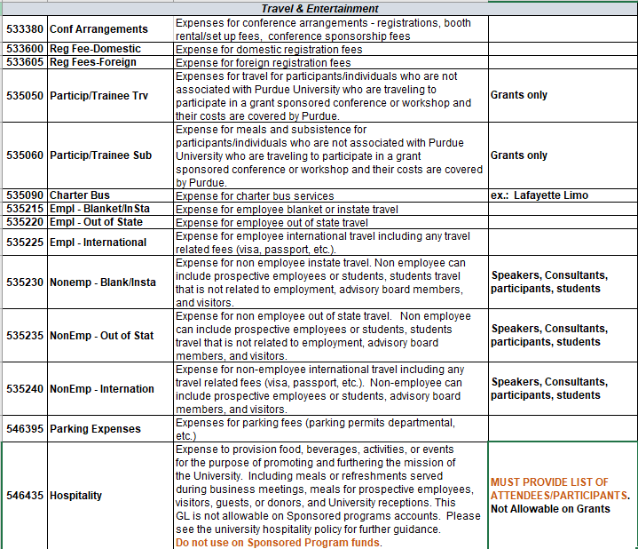
Business Office
Common GL List continued

Slide 50
Business Office
Tips & Tricks
Review every section of the forms before submitting to EOBOC via TDX. Once they send it back with errors to be fixed it delays reimbursement payment.
When submitting Hospitality expenses, please place in the Comments section of TDX the Business Purpose
EOBOC would like the forms put together in this order, in PDF Format: Payee Cert, Sub W-9, Receipts, and E-mail (Glacier if applicable).

Slide 51
Contact Information
EOBOC Procurement:
procureeo@purdue.edu
General Business Office:
busproc@purdue.edu
Saundra (Sandy) Johnson
john1794@purdue.edu
Heather Underwood
hunderwo@purdue.edu
Michelle Gentry
mlgentry@purdue.edu

Slide 52
Business Office Contacts
Adam Wilson, DFA
Heather Underwood, Business Manager
Reece Dewell, Business Manager
Michelle Gentry, Lead Business Asst.
~Payroll
Sandy Johnson, Business Asst.
~Reimbursements, Credit Cards
Jonathan Maj, Research Acct Specialist
~Grants
Patty Whaley, Financial Analyst

Slide 53
Business Office

Slide 54
Business Office

