Slide 1

Business Office
PRF Guidelines and Credit Card Reconciliation
6/7/2024

Slide 2

Agenda
General Card Information
Card Security
  Storage
  Lost or Stolen Cards (Fraud)
  Resolving Errors, Disputes, Returns and Credits
  Cardholder Agreement
  Sign-Out Sheet
  Request Form
Reconcile Process
  Cycle Period
  Frequency
  Reconciler/Business Office Tasks
  TEAMS shared files
Card Purpose
  Checklist for Users
  Allowable/Unallowable Expenditures
Contacts
01/26/2024

Slide 3

General Card Information
PRF Commercial Cards are issued and supported by JP Morgan Chase
The card is intended to facilitate efficient expenditures of a School’s Discretionary and Institutional Program funds by providing this streamlined function for the procurement and payment process
Cards are ordered via completing an application with the Business Office.
Card distribution is conducted by the PRF Card Manager.
Cards are issued as MasterCard (MC), any vendor that takes MC will accept the card.
Restrictions are coded into the PRF cards but are permissible for use at restaurant, catering, grocery, hotel banquet charges.
  Blocks have been made for airlines, auto rentals and cash advances on all cards
All PRF expenditures are subject to Indiana Sales Tax
  Do NOT request tax exemptions when using a PRF card
Renewal cards will automatically be mailed to the PRF Card Manager and then distributed to the Business Office for distribution
01/26/2024

Slide 4

Card Security
Storage
  Cards should be stored in a locked, secure location
Lost/Stolen Cards (Fraud)
  Immediately contact the bank and Business Office
  Business Office will notify the PRF Card Manager for card cancellation
  Please provide the below when reporting:
    Card number
    Transaction dates
    Vendors
    Amounts
  Copies of all correspondence and notes are to be sent to the Business Office which will provide to the PRF Card Manager in case of fraudulent card activity
  We cannot dispute fraudulent charges. The bank will investigate and issue a credit if it is determined the bank can recover the charges or it is determined the vendor did not use proper procedures. A new card will be reissued.
01/26/2024

Slide 5
Card Security
Resolving Errors, Disputes, Returns and Credits
  First step is to go back to the vendor and try to resolve the discrepancy
  If a resolution cannot be met with the vendor, next step is to contact the bank’s Customer Service Department 800-316-6056
  Dispute form should be filed no later than 60 days from the transaction posting date
  Reference number is the assigned ID from the bank’s Customer Service
  Disputing billing can result from: (not an inclusive list)
    Failure to receive good/services
    Defective merchandise
    Incorrect amounts
    Arithmetic errors
    Duplicate charges
    Credits not processed
  If unable to reach a resolution with the bank, the business office will contact the PRF Card Manager 765-588-3338
01/26/2024

Slide 6
Card Security
How to Dispute a Transaction
Before you dispute a transaction, you must first attempt to resolve the issue directly with the merchant! Disputes can be initiated online up to 60 DAYS from the transaction date.
Log onto the bank's Web site.
1. Choose Transactions, and then select Manage. From the transaction list, click on the transaction to dispute.
2. Click dispute. The transaction dispute screen will be displayed.
3. Confirm your email address and enter the Merchant State, if necessary.
4. Choose the dispute reason from the drop-down menu.
5. The page will refresh, displaying the additional information box. Enter all required information. An asterisk (*) marks required fields.
6. Click - Submit
A yellow square indicator will appear in the Transaction ID column for the disputed transaction, representing the transaction is queued for processing. The indicator icon appears green when the dispute is resolved.
To undo a dispute while the indicator square is yellow, click directly on the yellow square and select
Cancel/Undo Dispute
When resolved - You will receive a system generated email advising that the dispute is resolved.
01/26/2024

Slide 7
Card Security
Cardholder Agreement (Appendix B)
  Any first violation of the guidelines may result in immediate cancellation of PRF card
  Unallowable expenditures result in reimbursement of charges by the employee with possible cancellation of PRF card
  Personal expenditures will result in reimbursement of charges and/or disciplinary actions that can include suspension, terminations and prosecution under state and federal laws.
Sign-out Sheet (Appendix C)
  This form is required before each use of the PRF card
    Provide detailed activity description
    List of attendees (if applicable)
    Amount requested
  Original, Itemized receipts must be returned with the card after each use within 24 hours of use
Request Form (Appendix C-1)
  This form is optional
  This form provides more detailed information to be provided by the requestor
01/26/2024

Slide 8
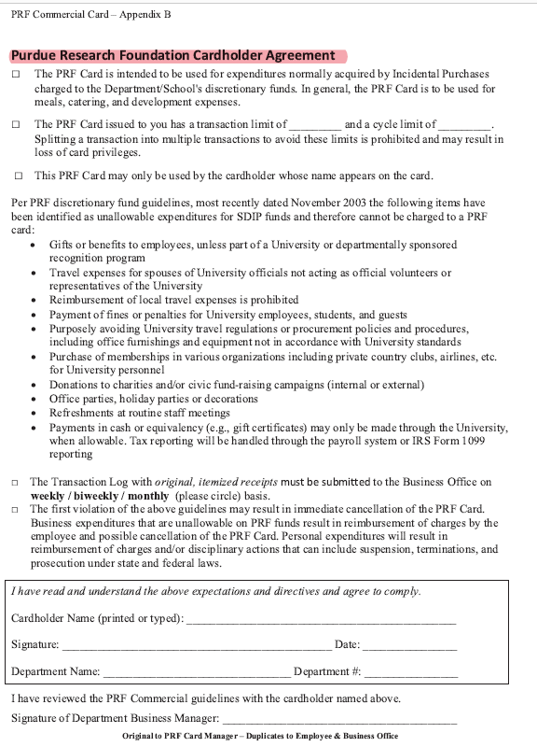
Card Security
Cardholder Agreement (Appendix B)
01/26/2024

Slide 9
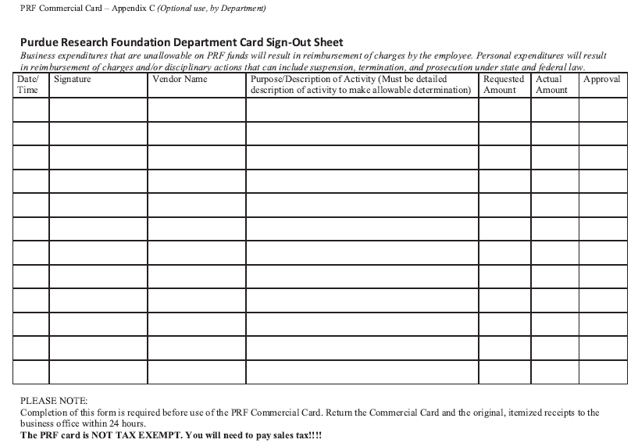
Card Security
Sign-out Sheet (Appendix C)
01/26/2024

Slide 10
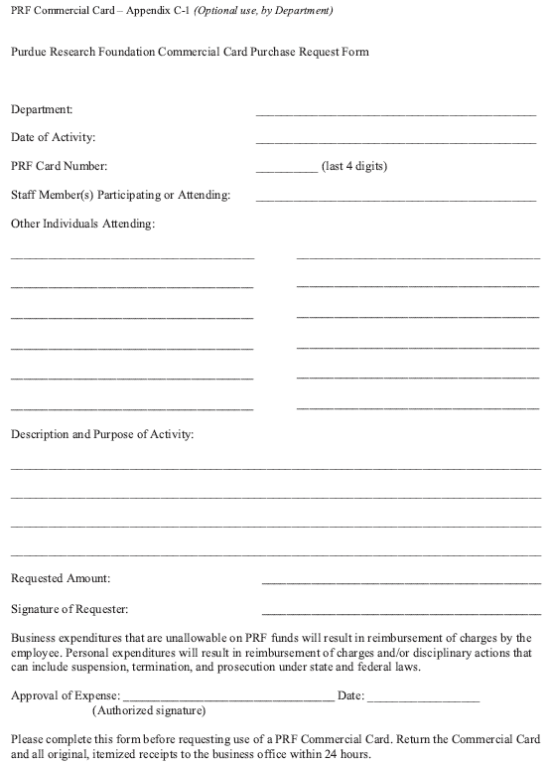
Card Security
Request Form (Appendix C-1)
01/26/2024

Slide 11
Reconcile Process
  Cycle Period
    16th through the 15th each month
    Expenses will charge to the account around the 21st of each month
  Frequency
    Reconcilers should have the previous cycle’s transactions reconciled against the JP Morgan’s transaction report by the 20th of each month
  Reconciler Task
    Reconciler will compare the JP Morgan’s transaction report against itemized receipt(s)/packing slip backup
    Within the JP Morgan site, accounts listed should only be the ones assigned to that Reconciler
    Reconcilers should save each cycle’s sign-out sheets, itemized receipts/packing slips, JP Morgan transaction report and expense justification explanation under their TEAMS folder
    If a transaction discrepancy is found, a dispute form must be completed and forwarded to the bank w/in 60 days of the transaction’s posting date
  Business Office Reconciliation Task
    Business Office will compare the saved documentation in TEAMS and will reconcile against the Cognos PRF report
    Business office will audit logs and transaction allowability
    Once review finalized, business office will sign documentation electronically and retain per retention guidelines
01/26/2024

Slide 12

Reconcile Process
  TEAMS shared files
    TEAMS site has been created for Reconcilers
    Each Reconciler will have a named folder
    Reconcilers should submit their monthly review of transactions via their named folder
    Submission should include:
      JP Morgan Transaction Report
      Sign-out log (Appendix C)
      Original itemized receipts (if a receipt is not available, an explanation must be attached)
      Add’l backup documentation (Expense Justification/Reconciled Document)
01/26/2024

Slide 13
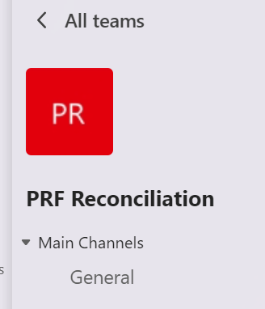


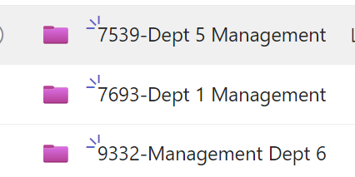
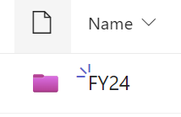
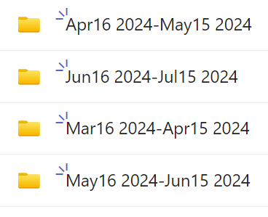
Reconcile Process
How to get to your TEAMS Folders
01/26/2024

Slide 14
Reconcile Process
Reconciler will log into www.paymentnet.jpmorgan.com using the UserID provided to the Reconciler by the PRF Card Manager and the password that the Reconciler created.
  ➢ Click Log In
01/26/2024

Slide 15
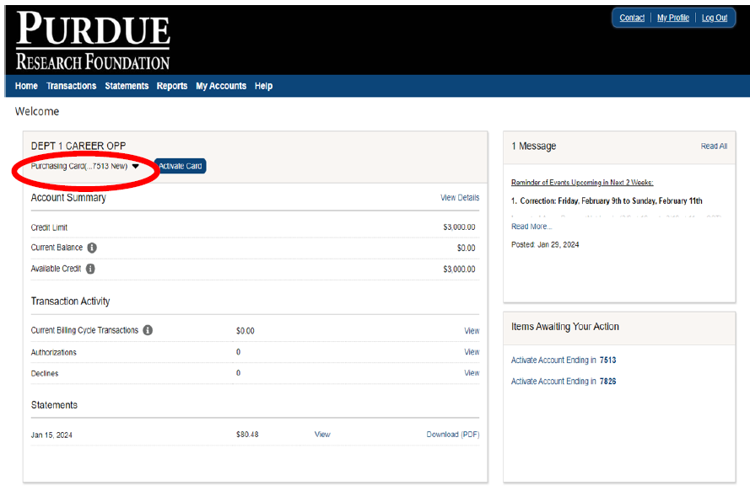
Reconcile Process
  After logging in, the Home page will provide the following information for each PRF card:
    Credit Limit
    Available Credit
    Option to activate cards
    Dropdown box allows the Reconciler to see each PRF card they are responsible for
01/26/2024

Slide 16

Reconcile Process
In order to see statements for each PRF card and for each cycle, click ‘Statements’ in the blue area at the top of the page.
This directs the Reconciler to the Statement Detail page.
  On this page, the option to select any of the PRF cards is available
  The option to select the cycle needing reviewed is available
On the ‘Statement Detail’ page:
The Reconciler can choose the PRF card that needs reconciled by selecting it in the dropdown menu in the ‘Account Number’ field.
Cycles can be chosen from the dropdown menu in the ‘Billing Date’ field
  Example: To see that statement for 11/30/23 transaction, the Reconciler will choose ‘Billing Date’ 12/15/23- this provides all the transactions for 11/16/23-12/15/23.
01/26/2024

Slide 17
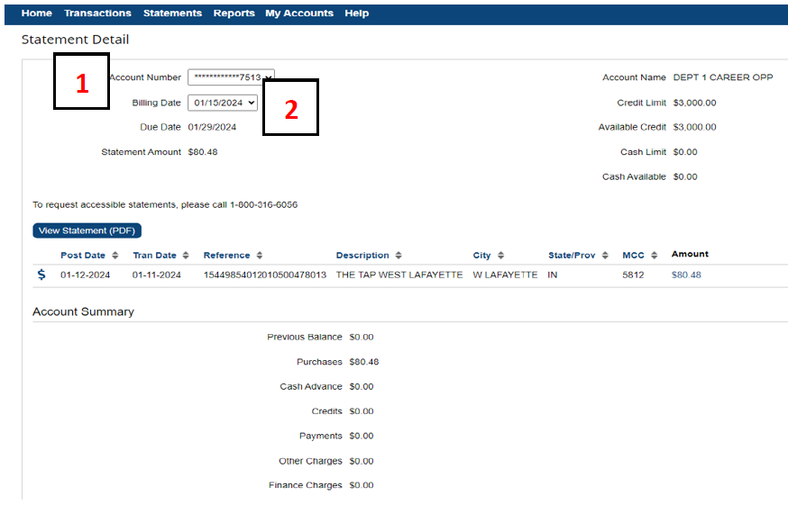
Reconcile Process
Statement Detail Example:
01/26/2024

Slide 18
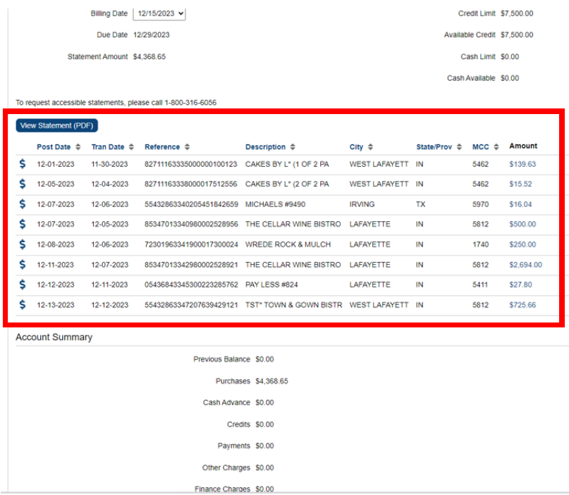
Reconcile Process
Review each transaction and verify there is backup documentation for each expense and that each expected expense made has been posted to the PRF account.
01/26/2024

Slide 19
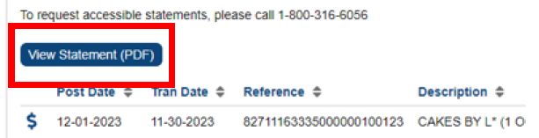
Reconcile Process
On the Statement Detail page, the Reconciler can pull the statement in PDF format by clicking the ‘View Statement (PDF)’ button on top of the transaction listings page.
  This provides a full PRF card statement with transactions, cycle limits and total expenses.
  NOTE: The pdf statement lists the entire PRF card number at the top of the statement. If this statement is distributed to others w/o authority to view, the account number must be redacted.
01/26/2024

Slide 20
Card Purpose
Allowable Expenditures- Must support the learning, discovery and engagement missions of the University
Examples of Allowable Expenditures:
Meals or Refreshments
Expenditures for meals and refreshments that include alcoholic beverages for University guests and the staff who host them at University functions must be paid from SDIP funds.
However, if the expenditures do not include alcoholic beverages, the meal and/or refreshments may be paid from University funds via a pcard.
Fund-raising expenses that are not appropriate on University funds. (Please refer to fundraising policies.)
Bereavement
Funeral flowers costing less than $100 and sympathy cards for students, staff and donors
01/26/2024

Slide 21
Card Purpose
Examples of Allowable Expenditures (cont):
Flowers/Cards
Seasonal flowers to decorate common areas (excludes individual offices)
Birthday, congratulatory, thank you or holiday cards for donors
Placards and Mementos
Those expressing appreciation to donors
Those expressing appreciation for long-term service of staff, or safety achievement, as part of University/departmentally sponsored recognition program with total value of such may not exceed $400 (Recipient must have more than 5 years of service)
Those of little intrinsic value given as gifts to non-staff volunteers
Miscellaneous
Coffeepots/small appliances for office kitchens/conference rooms
Sponsorships when used for public relations purposes or advertisement of recognized Purdue program
01/26/2024

Slide 22
Card Purpose
Examples of Unallowable Expenditures:
Expenditures providing personal benefit to individuals
Gifts or benefits to employees, unless part of a University or departmentally sponsored recognition program.
Travel expenses for spouses of University officials not acting as official volunteers or representatives of the University. See guidelines for official volunteers.
Reimbursement of local travel expenses is prohibited.
Payment of fines or penalties for University employees, students, and guests.
Purposely avoiding University travel regulations or procurement policies and procedures, including the purchase of office furnishings and equipment not in accordance with University standards.
Purchase of memberships in various organizations including private country clubs, airline clubs, etc., for University personnel.
Office parties, holiday parties, or decorations.
Payments in cash or equivalency (e.g., gift certificates) may only be made through the University, when allowable. Tax reporting will be handled through the payroll system or IRS Form 1099 reporting.
01/26/2024

Slide 23

Alcohol Use
Reimbursement for alcoholic beverages is allowable in conjunction with another reimbursable activity
Alcohol purchases are NOT allowable on University general funds
When purchasing food and alcohol at the same event, process the food purchase via a pcard and alcohol purchase via PRF card
The use of alcoholic beverages in University facilities is limited; see Executive Vice President and Treasurer Memorandum A-16.
DSB has an alcohol exception for purchase on conference/program funds
  In order to use the exception, approval must be obtained from the business office
01/26/2024

Slide 24

Contact Information
JP Morgan Chase Lost or Stolen:
800-848-2813
    Available 24 hours a day, 7 days a week
    Immediately notify if card is lost/stolen
JP Morgan Customer Service:
800-316-6056
    Available Monday through Friday 7am to 7pm CST
    Assist with why a charge was declined for purchase of goods and can provide copies of sales drafts
PRF Credit Card Manager:
    Notify DSB Business Office and we will contact the Credit Card Manager when applicable
01/26/2024

Slide 25

Business Office Contact Information
General Business Office:
  busproc@purdue.edu
Adam Wilson, DFA
adamwilson@purdue.edu
Reece Dewell, Business Manager
radewell@purdue.edu
Heather Underwood, Business Manager
  hunderwo@purdue.edu
Jonathan Maj, Research Account Specialist
jmaj@purdue.edu
Michelle Gentry, Business Asst
mlgentry@purdue.edu
Sandy (Saundra) Johnson, Account Clerk
john1794@purdue.edu
Patty Whaley, Financial Analyst
pwhaley@purdue.edu
01/26/2024

Slide 26

01/26/2024

Slide 27

01/26/2024

